Slide 1
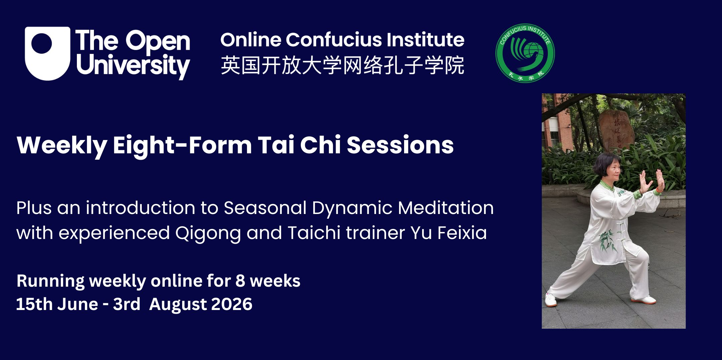

Slide 2
Tai Chi & Qigong for Mental and Physical Wellbeing
A series of dynamic meditation classes that combine gentle stretches, flowy movements with deep abdominal breathing to relax the body, calm the mind and recharge your energy.
Feixia Yu
Honorary Principal Lecturer at University of Lancashire
fyu8@lancashire.ac.uk , YuTaichi4You@gmail.com

Slide 3
Week 1
Introduction to Tai Chi
Opening, closing stances
Tai Chi Movement 1

Slide 4
The Eight-Form Tai Chi
Origin and purpose: rooted in Yang style, further simplified from the 24-Form Simplified Tai Chi, a modern creation born from a mid-20th century public health movement in China. Its genius lies in its distillation of a profound ancient art into a simple, effective, and universally accessible exercise routine.
This is the third time we are running this course. If you are totally new to Tai Chi, be patient and allow your body time and plenty of repetitions to get used to a total new way of moving the body. Tai Chi is often described as an art of shifting your body weight, it is also known as a Moving Meditation and Moving Medication.
If you are a returner, congratulations for making the decision for more in-depth study. You will find more details to help you deepen your practice. It is through lots of mindful practice that you get into the flow state, when you reap the maximum benefit of this gentle exercises of low to medium intensity. Synchronize your breathing with the movements and connect the mind to the movements. This way, the mind is calm, heart rate and breathing slow down, both mind and body more relaxed and refreshed.
This very simple routine lays a good foundation if you want to embark on more complicated and long forms of Taichi of different styles.
My favourite YouTube demonstration of a couple mirroring the routine is here. Try to practice every day.
https://www.youtube.com/watch?v=lH4JZ6aqCbA

Slide 5
The names of the movements in 8-Movement Tai Chi are:
预备势: Preparation
起势: Opening
1、 卷肱势 Reverse forearms.
2、 搂膝拗步Brush knee push hand.
3、 野马分鬃 Part the wild horse's mane.
4、 云手Cloud hands.
5、 金鸡独立 Golden rooster stands on one leg.
6、 蹬脚 Kick with Heel.
7、 揽雀尾Grasp the bird's tail.
8、 十字手Cross hands.
收式： Closing

Slide 6
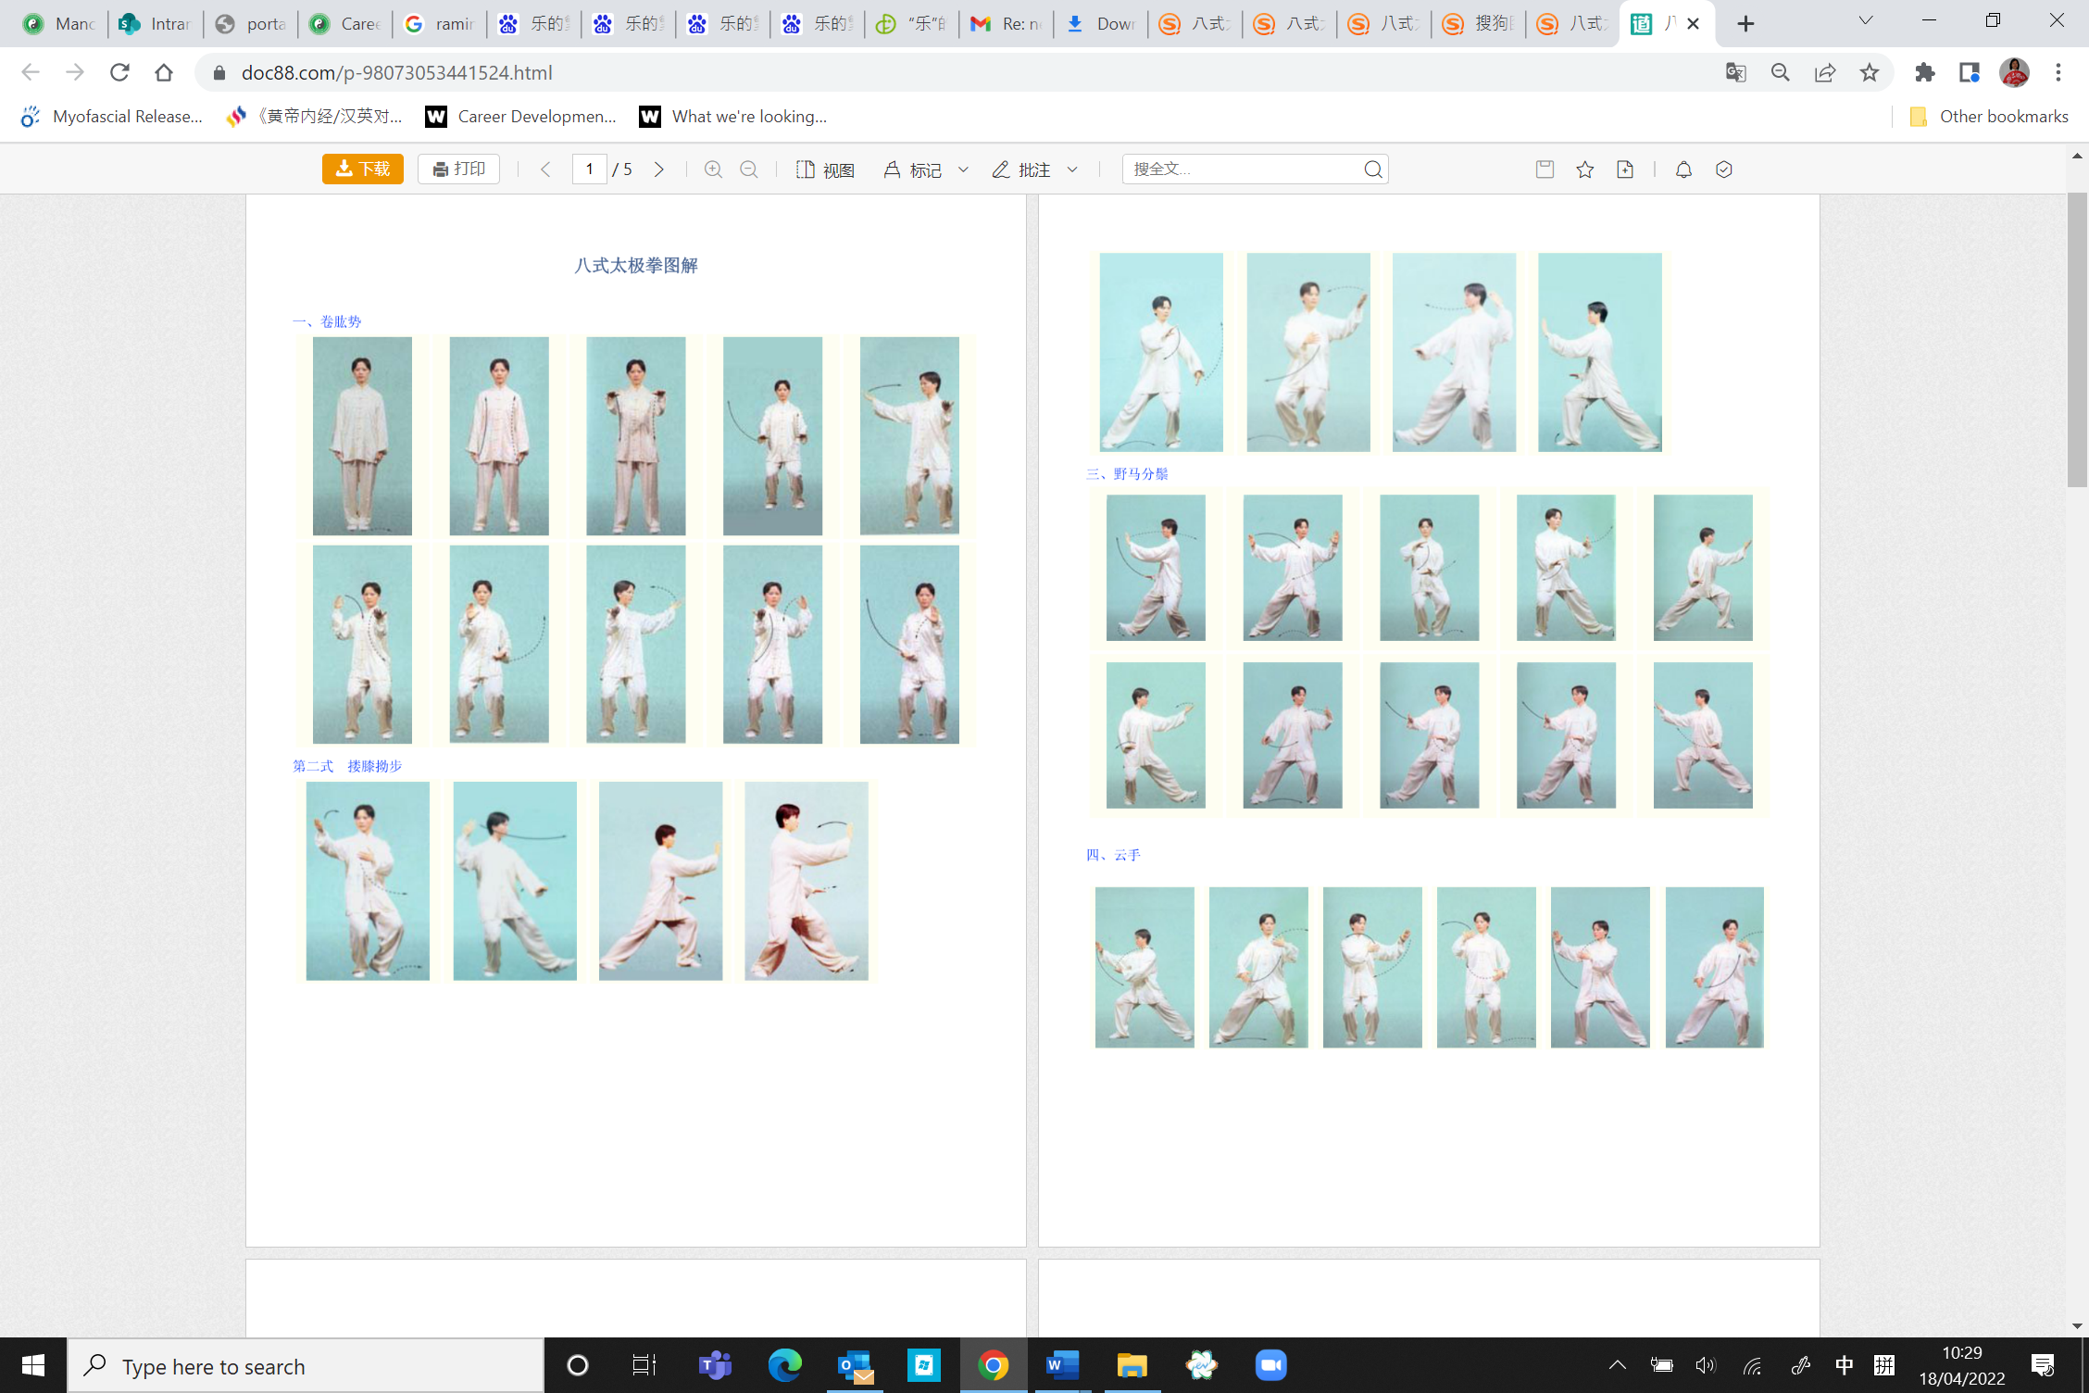
Illustration of the first movement 卷肱式 Reversing the forearms

Slide 7
Practice tips, Cool down routines and their importance
Practice tips:
以腰为轴 Use the waist as the axis
Let the waist guide and coordinate all movements. Power starts from the center.
上下相随 Synchronize upper and lower body
Hands, feet, and torso should move together as one connected flow.
迈步如猫形 Step like a cat
Move softly, slowly, and with awareness—light, quiet, and balanced steps.
Cool down routines
Drumming the heavenly drum & massaging the ears
Red dragon stirring the sea, rinsing and swallowing the saliva
Tapping on head, shoulders, torso, limbs along the direction of energy flow in the meridians
Shaking
Gathering the Qi back

Slide 8
Week 2
Tai Chi Movements 1 & 2
Introduction to 24 Solar Terms
1 Spring Movement

Slide 9
Q&A
On Breathing
This depends on your stage of training.
  For total beginners: breath naturally. This is because some masters believe too much focus on breathing for total beginners only stress out the learners, causing them to hold their breath etc. The belief is in time you will sync your breathing with your physical movements naturally. Other masters believe it is better to develop a good habit right from the beginning. It makes the training more effective and enjoyable, if you have spare capacity to do it, i.e. without straining your breathing. Remember, relaxation is the number 1 priority.
  As you progress, Let Movement Guide Breath
  起吸落呼Inhale on rising, exhale on sinking;
  开吸合呼Inhale on opening, exhale on closing;
  发力呼 Exhale on exerting force.
  As an advanced practioner, Let Breath Guide Movement
  Watch seasoned martial artists or Daoist monks when they practice.
  The golden rules for breathing in Taichi as well as Qigong: 细 Fine, 长 Long, 深 Deep, 匀 Smooth/Even
My favourite YouTube demonstration of a couple mirroring the routine:
https://www.youtube.com/watch?v=lH4JZ6aqCbA

Slide 10
Illustration of the first movement 卷肱式 Reversing the forearms

Slide 11
Illustration of the second movement 搂膝拗步Brush knee push hand

Slide 12
What is 24 Solar Terms
A traditional Chinese system that divides the year into 24 seasonal stages based on the sun’s annual motion.
Each term marks a recognisable shift in season, climate, and the natural world.
The system has been used to guide agriculture, daily life, and seasonal awareness.
UNESCO inscribed the 24 Solar Terms on its Representative List of the Intangible Cultural Heritage of Humanity in 2016
Further Readings:
https://www.the24solarterms.com/
UNESCO: The Twenty-Four Solar Terms
Further viewing:
https://www.youtube.com/watch?v=qTrd010vMp8

Slide 13
What is TCM Daoyin for 24 Solar Terms
Daoyin is a traditional Chinese practice combining movement, breathing, and mental focus.
In this approach, movements are organised around the 24 Solar Terms and their seasonal qualities.
Within the framework of traditional Chinese medicine, the exercises are designed to reflect seasonal patterns in nature and to help harmonise the body’s qi with those rhythms.
The practice connects body, breath, attention, and seasonality through gentle, mindful exercise.
Further Readings:
https://www.the24solarterms.com/
PubMed Central: Dao Yin (a.k.a. Qigong): Origin, Development, Potential Mechanisms, and Clinical Applications
https://onlinelibrary.wiley.com/doi/full/10.1155/2019/3705120

Slide 14
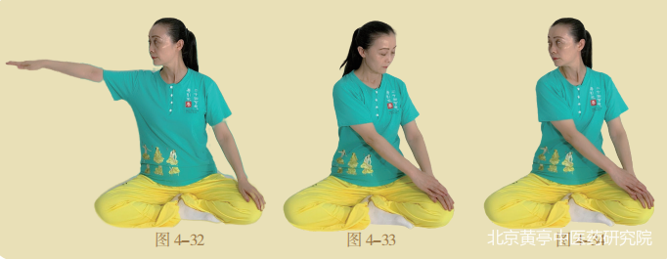
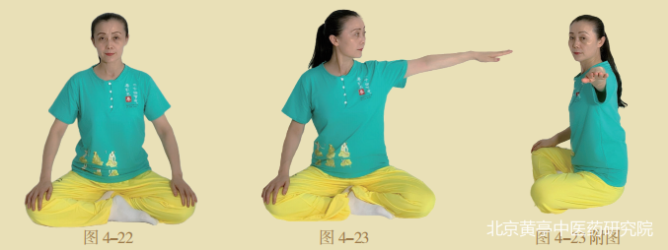
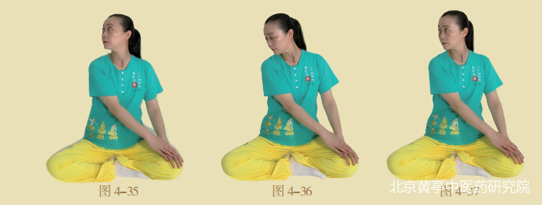
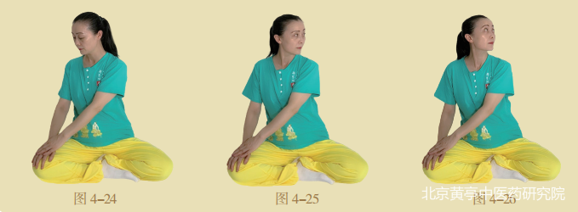
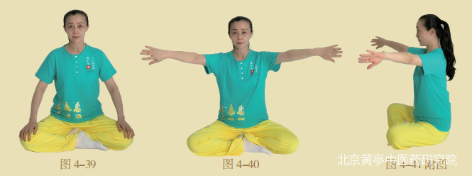
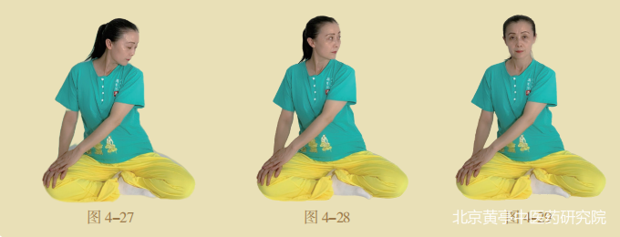
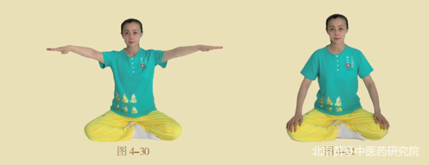

2. 雨水昂头望月式 (Yǔshuǐ Áng Tóu Wàng Yuè Shì)
Rain Water, Raising the Head to Gaze at the Moon

Slide 15
General questions on links:
  To request a recording: You will be automatically emailed a link to the week’s recording. But booking for every session on Eventbrite is essential.
  The recording is kept alive for a week if you need to catch up a missed a session or if you want to practice more.
  You are encouraged to attend the live session. We have a stronger energy field when practicing together.
  To sign up for OU Chinese modules:
  credit modules: https://www.open.ac.uk/courses/modules/l108/
  short courses: https://www.open.ac.uk/courses/short-courses/lg002/
  free courses: https://www.open.edu/openlearn/mod/oucontent/view.php?id=106436
  https://www.open.edu/openlearn/languages/getting-started-chinese-business-culture-essentials/content-section-0?intro=1
If you want to find out more of my other Qigong classes on Zoom, drop me a line at yutaichi4you@gmail.com
If you fancy joining me at a week-long qigong retreat in South France, here is more information: https://www.youtube.com/watch?v=UHvqcyaWznY
My favourite YouTube demonstration of a couple mirroring the routine:
https://www.youtube.com/watch?v=lH4JZ6aqCbA

Slide 16
Week 3
Tai Chi Movements 3
2 Spring Movements

Slide 17
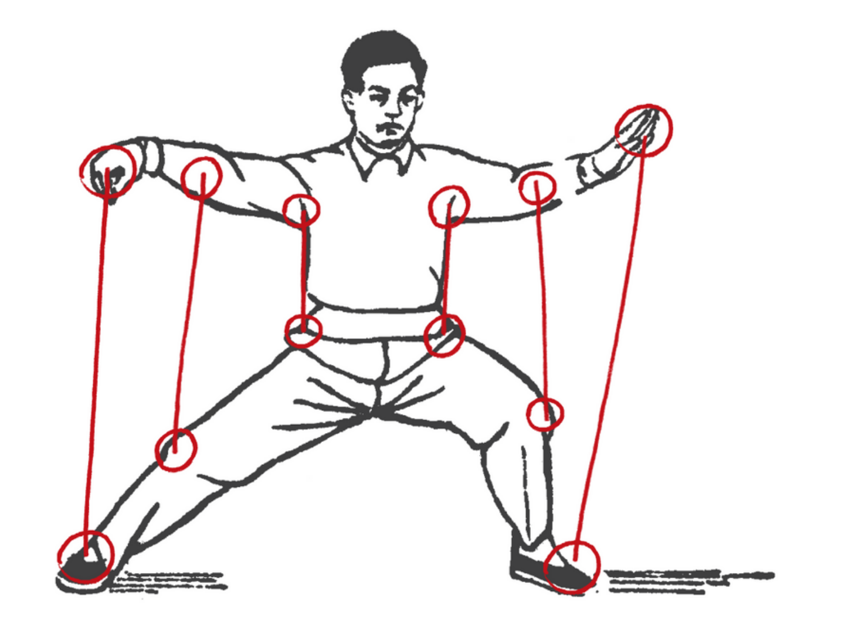
Q&A - continued
On coordination between arms and legs
  Q: What is the sequence of hand and leg movement? Hands first and then legs?
  A: No, we would like to be moving them in a more harmonized manner. 三合 three external harmonies
  肩与胯合 Shoulder and Hip move in unison – most important
  肘与膝合 Elbow and Knee move in unison
  手与脚合 Hand and Foot move in unison
  This is so that we move as a single, coherent whole. By consciously practicing to align your shoulders with your hips, your elbows with your knees, and your hands with your feet, you stop moving as a collection of separate limbs and start moving as one integrated unit, which is the very foundation of Taijiquan's power and grace.
  On the height of the stand
  Q: I heard keeping a low stand is good as it make one stronger. How do I achieve it?
  A: No need to keep a very low stand as a beginner. As your legs and core get stronger, you will be able to hold a lower stand without hurting your knees or compromising the integrity of your pose and movements.
  Q: I found myself bobbing up and down a lot at the beginning. How do I stop that?
  A: Relax the body, breathe into Dantian; and feel your feet deeply rooted to the ground.
  熟能生巧 Practice makes perfect.

Slide 18
Illustration of the third movement 野马分鬃 Part the wild horse's mane

Slide 19
2. 雨水昂头望月式 (Yǔshuǐ Áng Tóu Wàng Yuè Shì)
Rain Water, Raising the Head to Gaze at the Moon

Slide 20
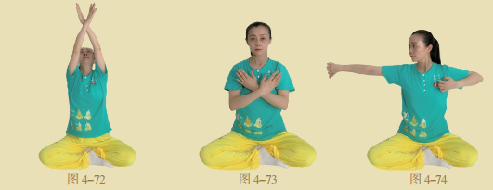
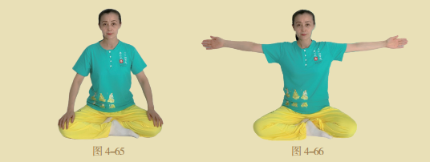
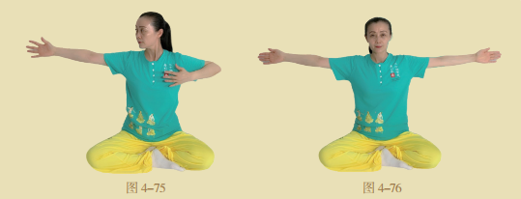
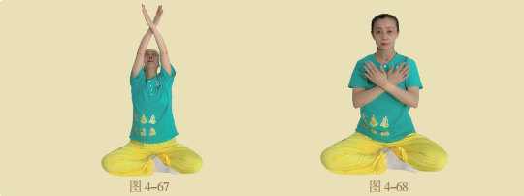
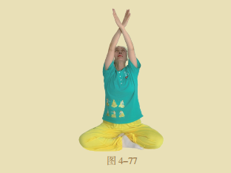
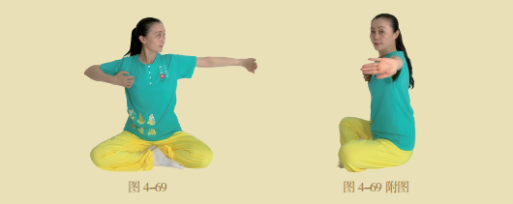
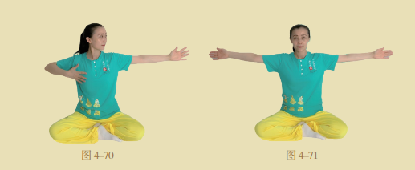
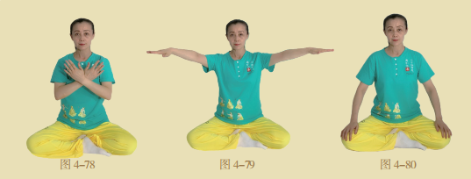
5.清明开弓射箭式 Qīngmíng Kāigōng Shèjiàn Shì
Pure Brightness: Drawing a Bow to Shoot an Arrow

Slide 21
Week 4
Tai Chi Movement 4 & revision
1 Summer Movement

Slide 22
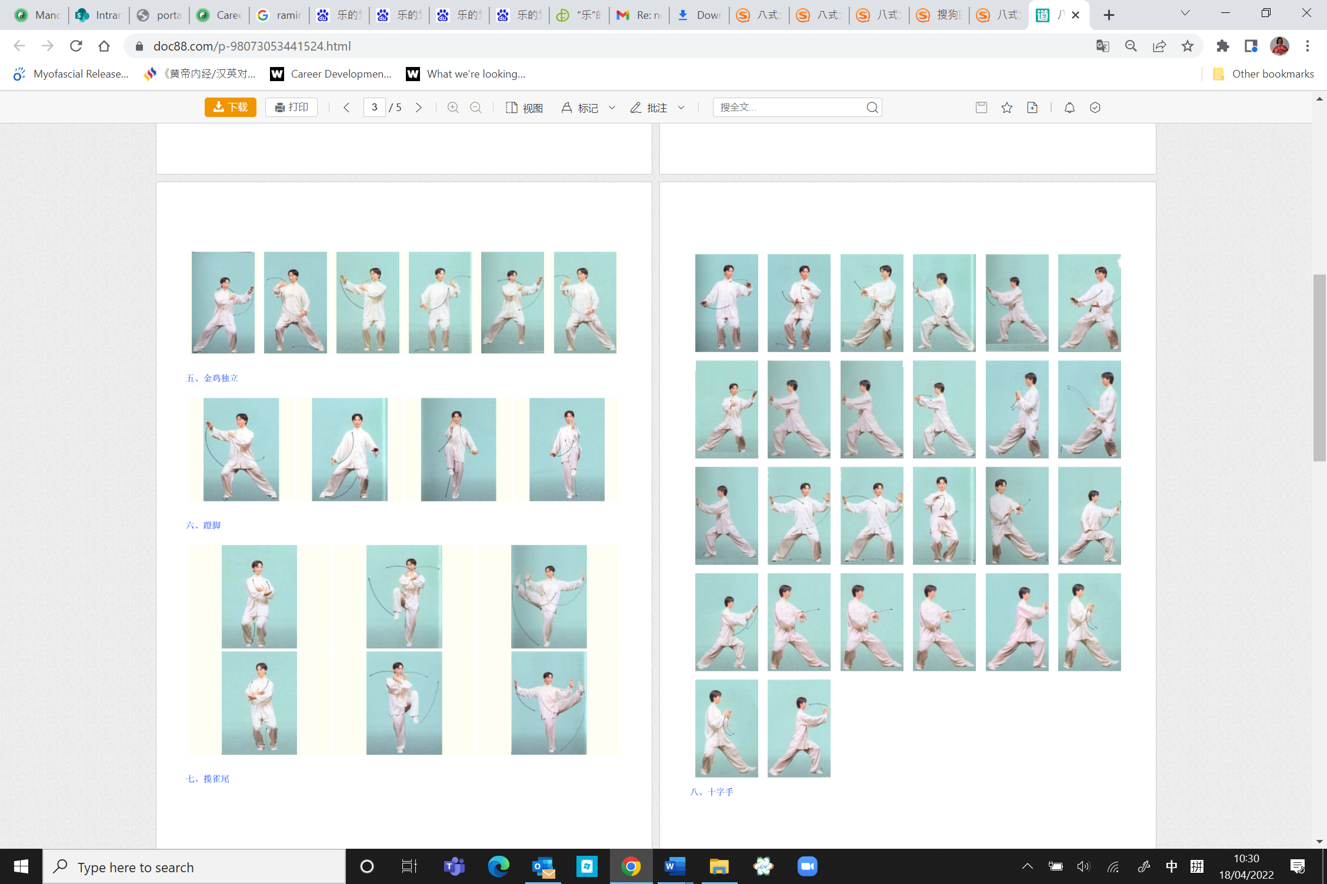
Illustration of the fourth movement 云手Cloud hands.

Slide 23
Practice tips
云手 (Yún Shǒu – Cloud Hands)
Key Points
Movement is continuous and circular, like clouds drifting across the sky.
The waist (胯 / kuà) leads the motion — hands follow the rotation of the torso.
Hands move horizontally at chest level, maintaining a smooth, coordinated flow with steps.
Body weight shifts evenly from one leg to the other; feet remain rooted, steps light and agile.
Shoulders and elbows stay relaxed, wrists soft.
Intended Benefits
Improves coordination between upper and lower body.
Enhances waist flexibility and control (core movement).
Trains smooth, even breathing and calm mental focus.
Promotes balance and fluid transitions.
-

Slide 24
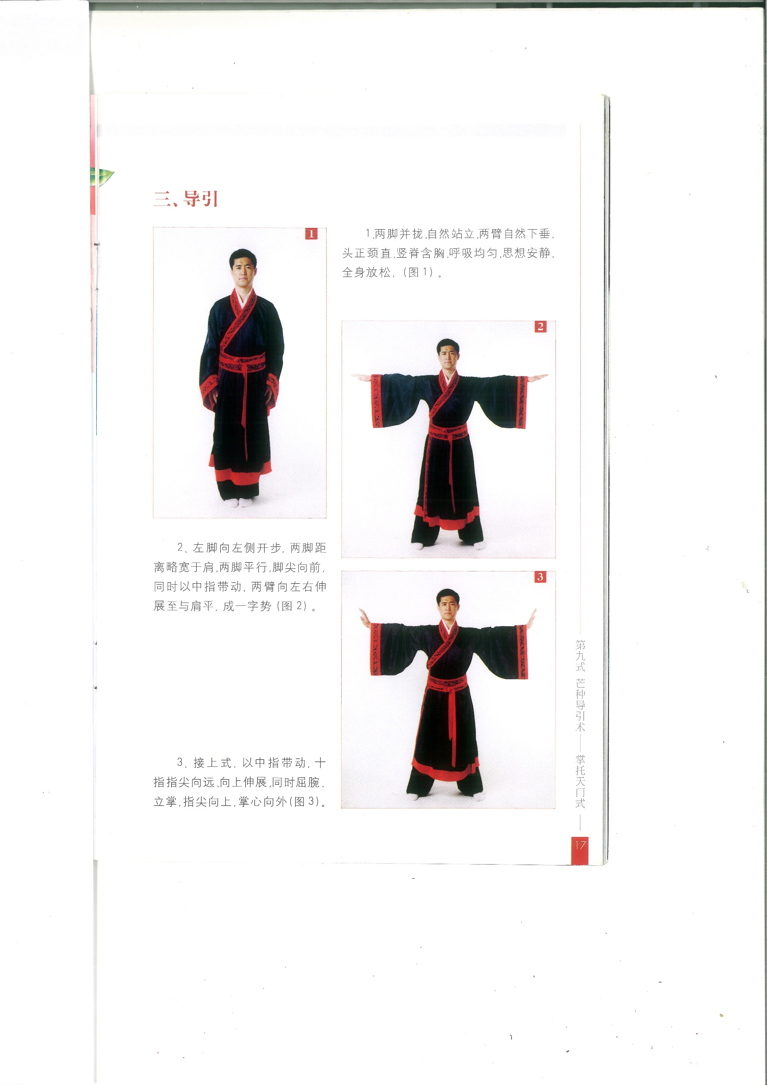
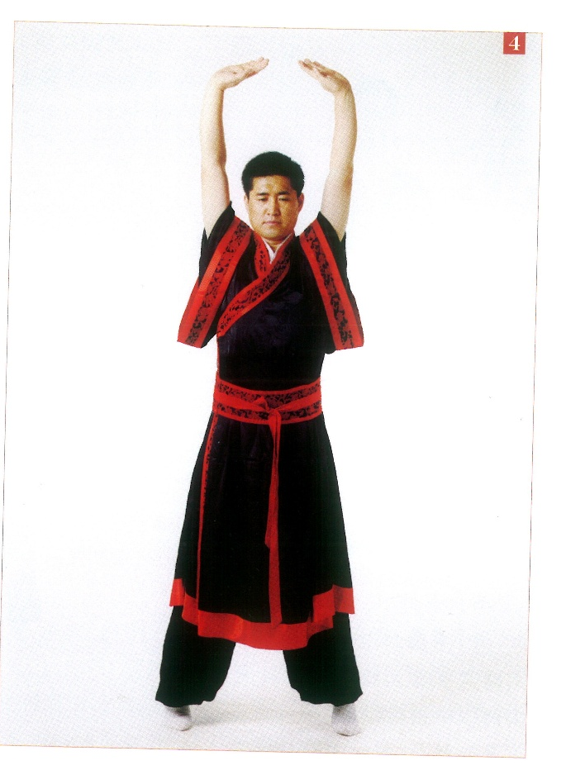
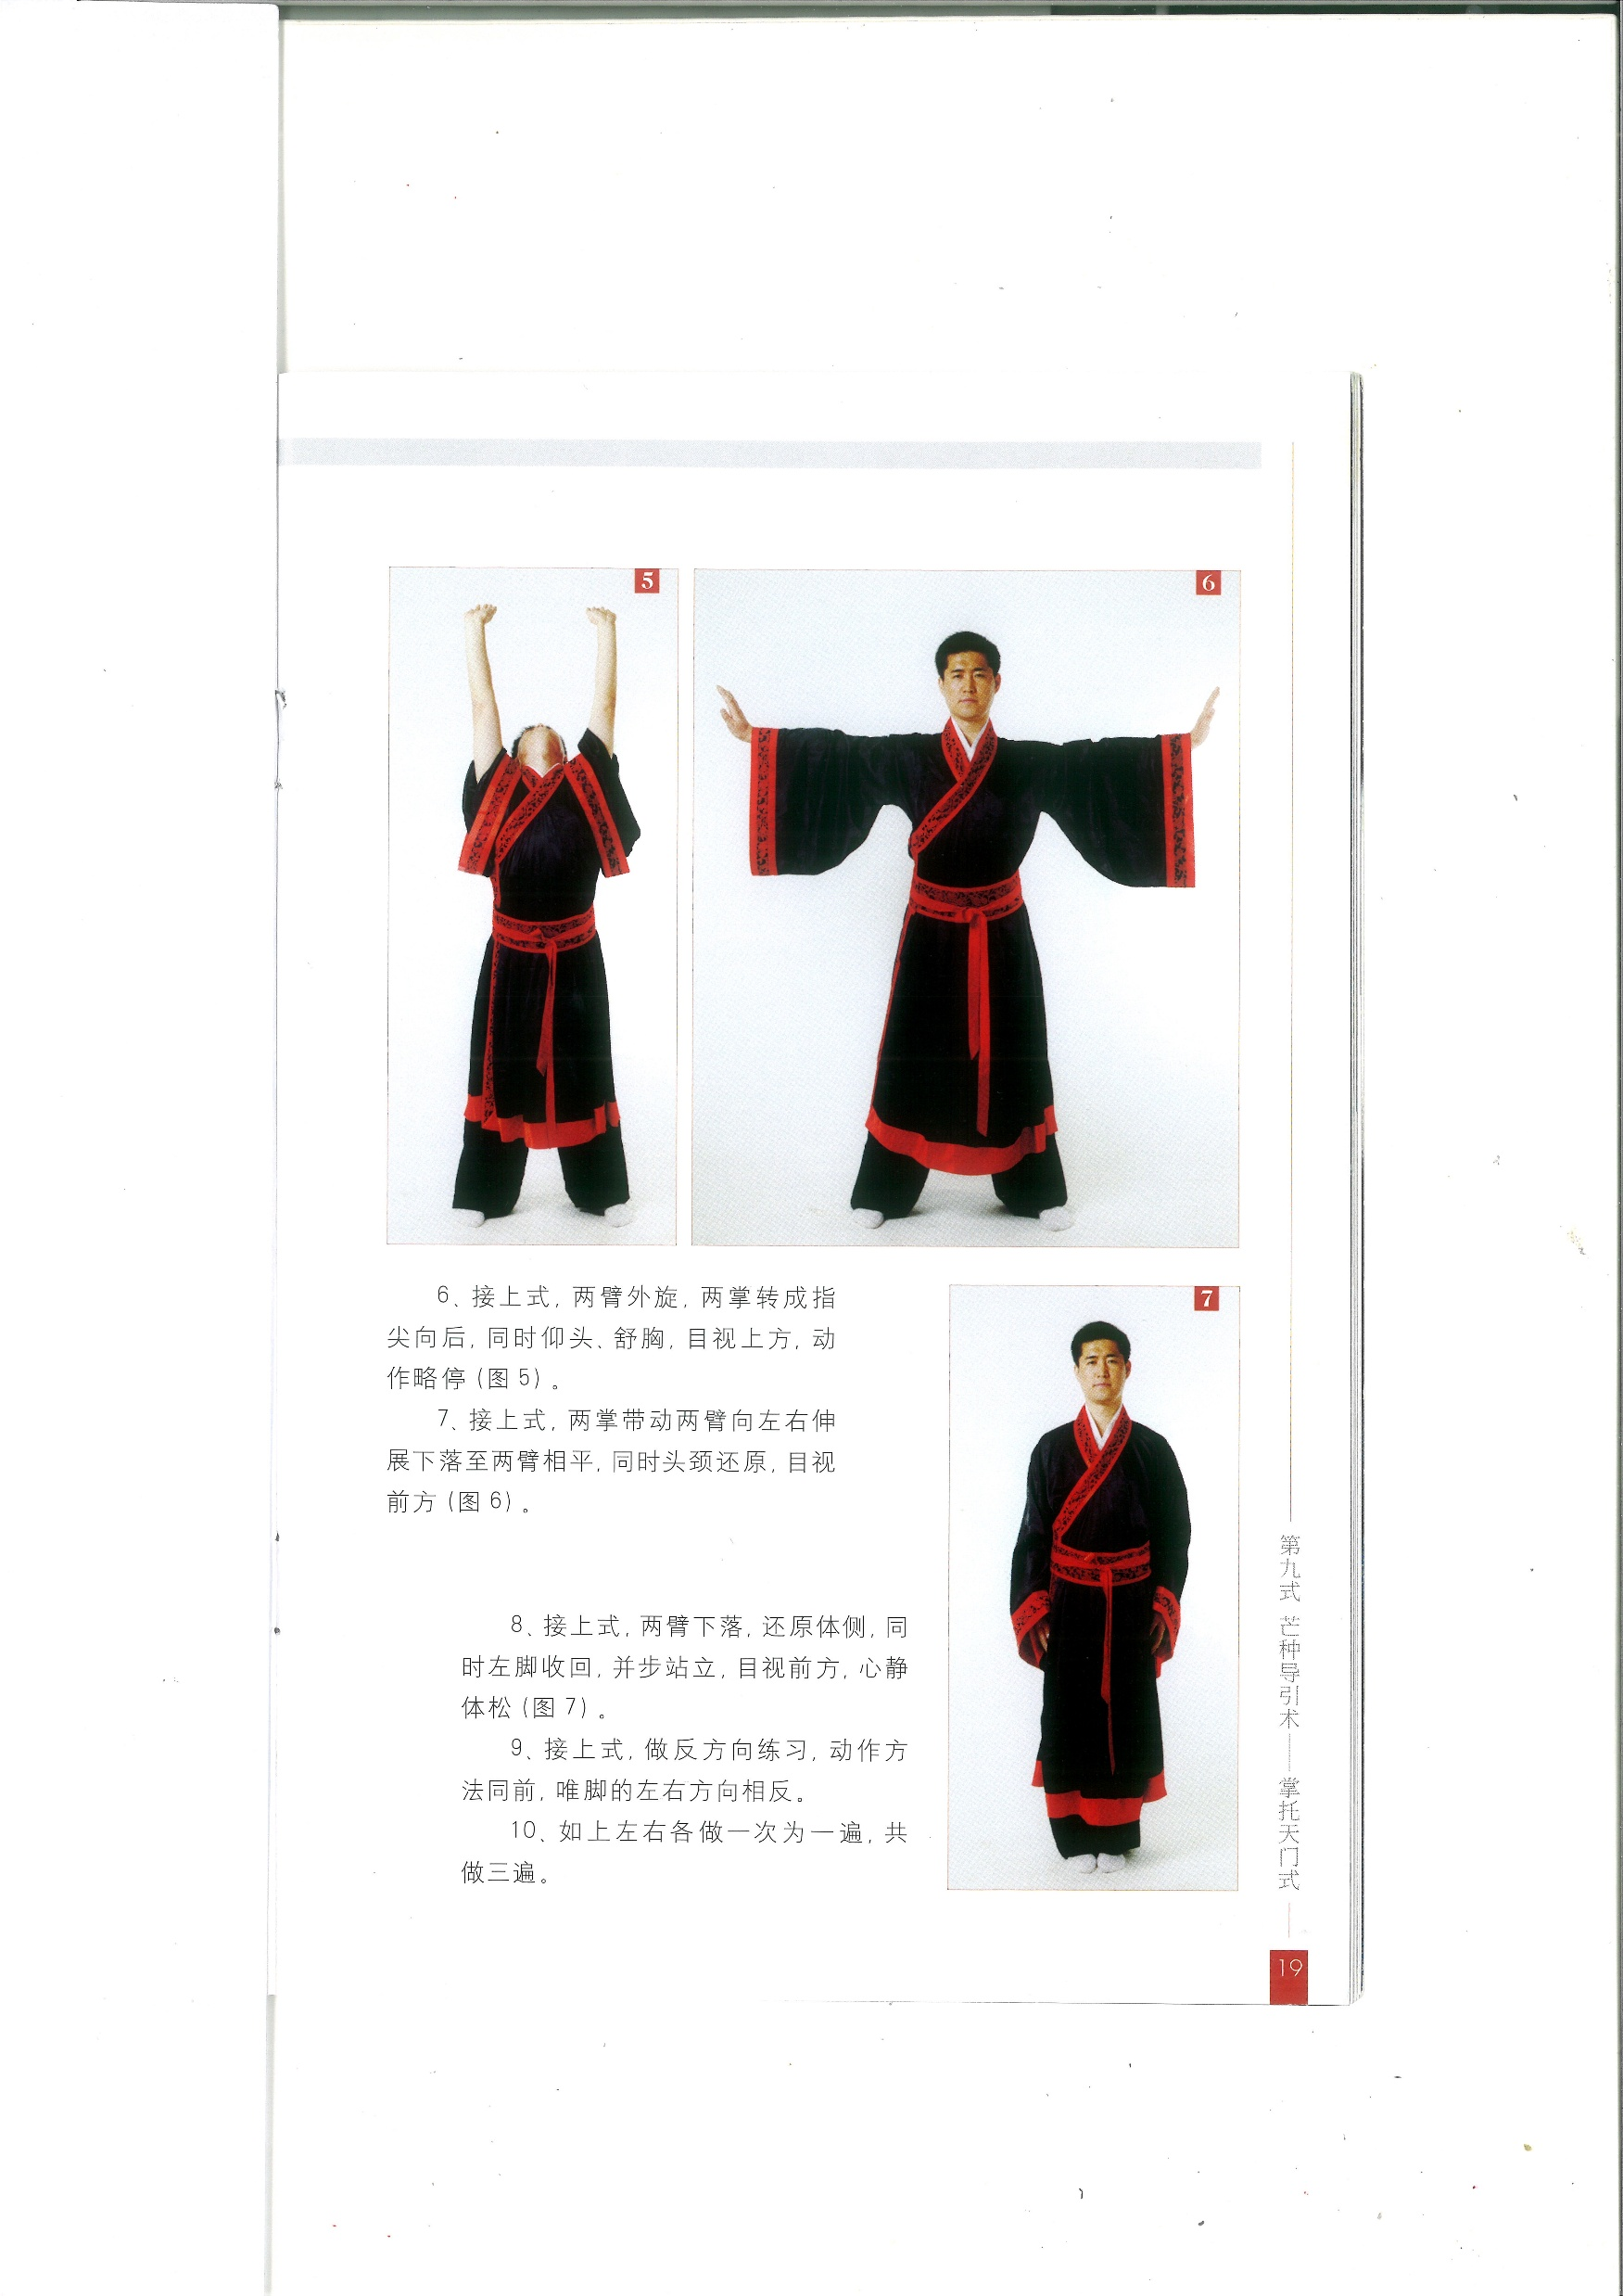
3. 芒种掌托天门式 Mángzhòng zhǎng tuō tiānmén shì Grain in Ear: Palms Supporting the Gate of Heaven

Slide 25
Week 5
Tai Chi Movements 5 & 6
2 Summer Movements

Slide 26
Illustration of the fifth movement 金鸡独立 Golden rooster stands on one leg

Slide 27
Practice tips
金鸡独立 (Jīnjī Dúlì – Golden Rooster Stands on One Leg)
Key Points
Stand tall on one leg; spine upright, crown lifted (顶头悬).
Supporting leg rooted and stable; lifted knee high, relaxed but controlled.
Hands rise — one up in front of the body (guarding), one down near the side — forming vertical balance.
Eyes focus forward, breathing calm.
Intended Benefits
Strengthens legs, ankles, and balance control.
Enhances single-leg stability and coordination.
Trains focus, stillness, and mental centering.
Develops the "rooting" skill essential in Taichi.
-

Slide 28
More Practice Tips
金鸡独立 Golden rooster standing on one leg
This is great for balance. Start raising your leg a little bit off the floor, and you can start next to the wall or at the back of a chair in case you need support. As you progress, raise the knee level to your hip and even higher, and hold for a little longer while keeping the torso upright. Look for smoothness in your movement.
Three more practice tips
心静体松 Calm the mind and relax the body
The two support each other. Feel like a tree: the mind is still like calm air, the body soft like leaves swaying in the breeze. Not tense, not limp — gently alert and rooted.
眼随手走 Eyes follow the movement naturally
Soft gaze, eyes lead the spirit (神）, which leads the energy. Direct attention in the direction of the flow
虚实分明 Clearly distinguish empty and solid, insubstantial and substantial
This refers mainly to weight distribution and energy awareness between the left and right legs. We want smooth
transition of your body weight between the legs.
-

Slide 29
Illustration of the sixth movement 蹬脚 Kick with Heel.

Slide 30
Practice tips
蹬脚 (Dēng Jiǎo – Heel Kick / Kicking Foot)
Key Points
Kick out with the heel, toes up — heel leads the motion.
Maintain upright posture; supporting leg rooted and strong.
Opposite hand pushes forward with the kick, maintaining balance and intention.
Movement is controlled — kick to height comfortable for stability, not for force.
Breath naturally, avoid strain.
Intended Benefits
Strengthens legs and waist.
Improves coordination, timing, and extension.
Enhances balance during dynamic movements.
Builds focus and energy projection (“意到气到”).

Slide 31
3. 芒种掌托天门式 Mángzhòng zhǎng tuō tiānmén shì Grain in Ear: Palms Supporting the Gate of Heaven

Slide 32
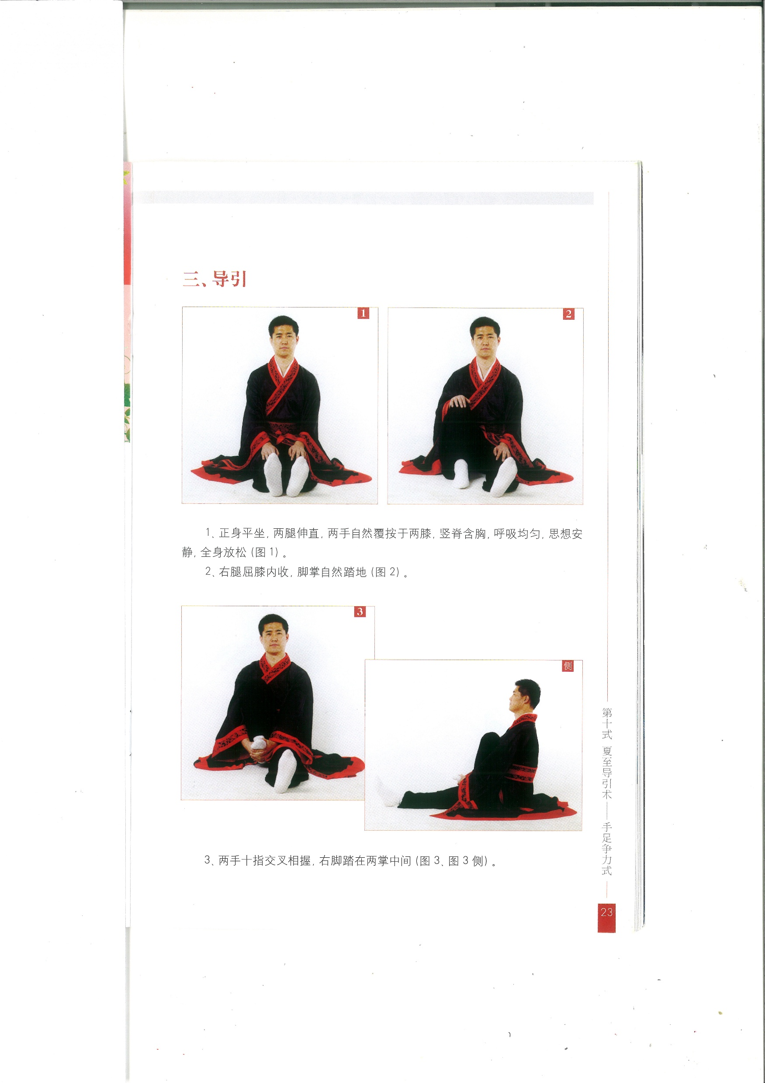
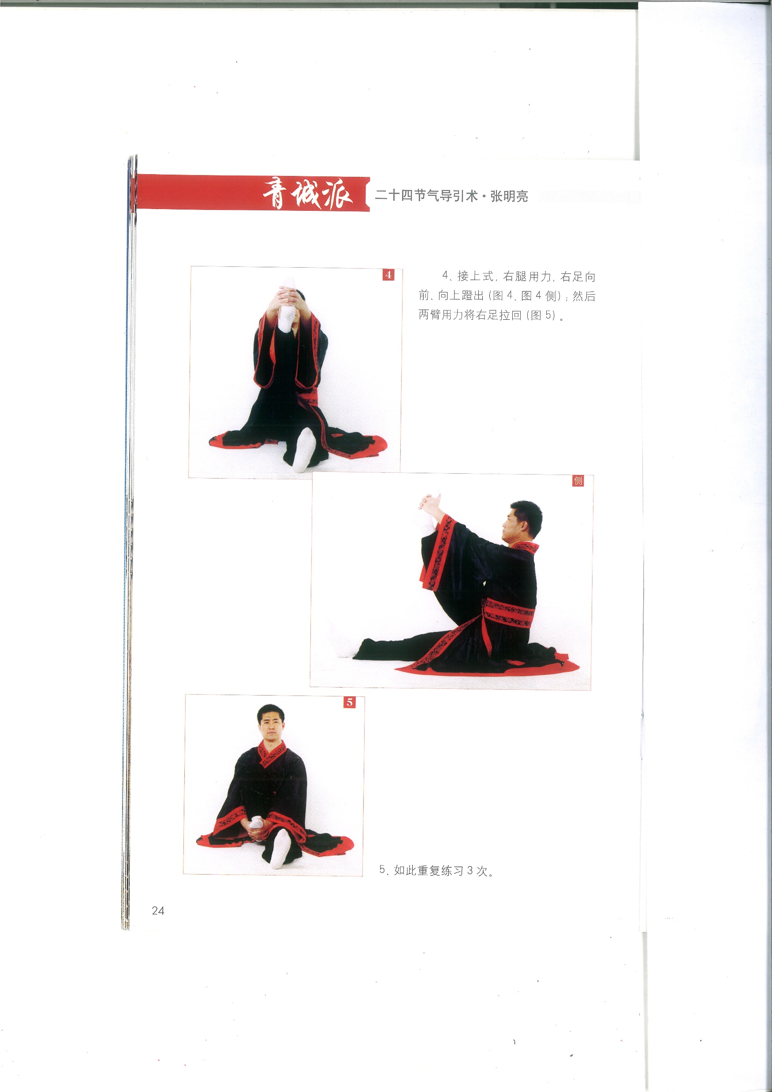
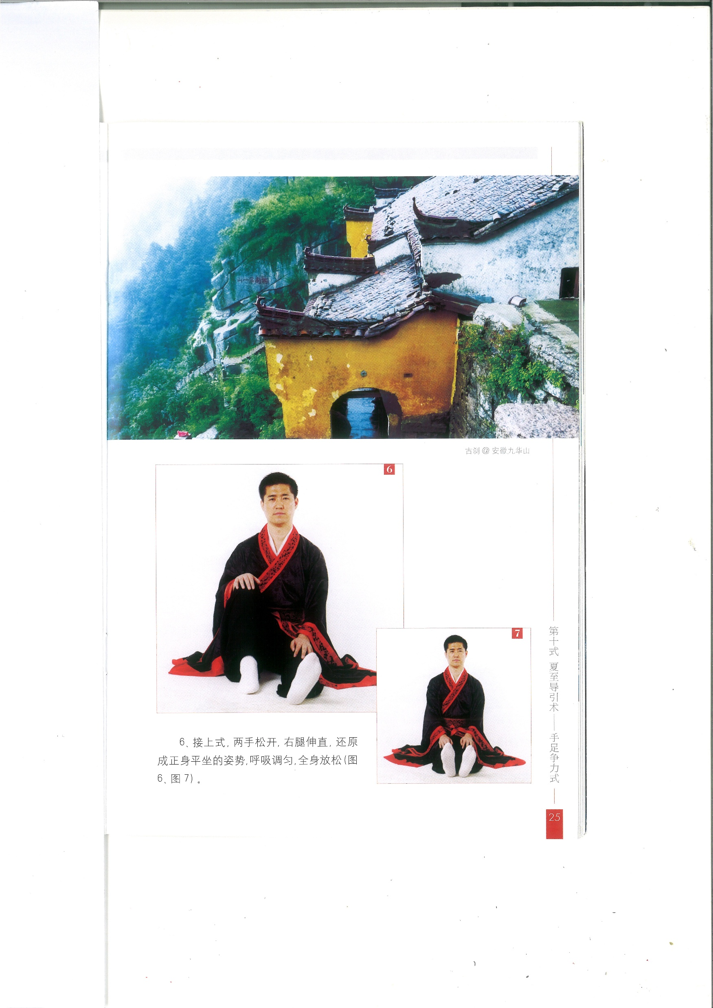
4. 夏至手足争力式 Xiàzhì shǒu zú zhēng lì shì Summer Solstice: Hands and Feet in Dynamic Opposition
This group depicts the stretch of the right leg first. After three reps, repeat the movements of the left leg three times.

Slide 33
Week 6
Tai Chi Movements 7
2 Autumn Movements

Slide 34
Illustration of the seventh movement 揽雀尾Grasp the peacock's tail.

Slide 35
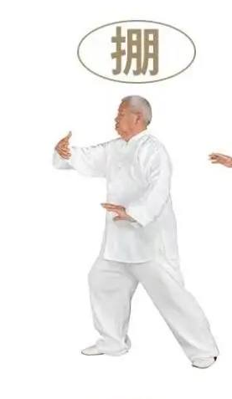
揽雀尾 Lǎn Què Wěi – Grasp the Bird’s Tail
This is one of the core sequences in Tai Chi, embodying its essential internal principles. It integrates the four fundamental energies (四正劲 sì zhèng jìn): 掤 Péng (Ward-off), 捋 Lǚ (Roll-back), 挤 Jǐ (Press), and 按 Àn (Push), -
掤 (Péng – Ward-off)
Key Points
Energy expands outward like a balloon being inflated — “supporting from within.”
The front arm forms a rounded arc, elbow drooping slightly.
The rear hand supports near the side; chest open, back full, waist leading.
Maintain upright posture, weight slightly on the rear leg, body relaxed but alert.
Intended Benefits
Cultivates expansive, buoyant energy.
Develops waist–arm coordination and structural integrity.
Strengthens awareness of internal connection (“one energy from foot to hand”).

Slide 36
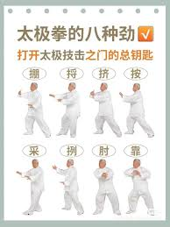
揽雀尾 Lǎn Què Wěi – Grasp the Bird’s Tail
捋 (Lǚ – Roll-back)
Key Points
Redirect incoming force by turning the waist and guiding energy to the side and back.
Hands form a circular path — one pulling slightly backward, the other following.
Weight shifts naturally to the rear leg; energy spirals through the body.
Focus on yielding, not retreating — the centre remains stable.
Intended Benefits
Trains listening energy (听劲) — sensitivity to direction and force.
Enhances waist flexibility and control of neutralization.
Promotes calmness and responsiveness rather than resistance.

Slide 37
揽雀尾 Lǎn Què Wěi – Grasp the Bird’s Tail
挤 (Jǐ – Press)
Key Points
Convert the redirected energy into forward pressure using both hands in coordinated push — one palm behind the other forearm, or wrist on wrist.
The force issues from the back foot through the waist, spine, and arms.
Elbows slightly bent, shoulders relaxed; maintain forward-rooted stability.
Intended Benefits
Develops coordinated forward energy (合劲).
Teaches how two arms combine power through structural alignment.
Trains focused projection of internal energy, not brute force.

Slide 38
揽雀尾 Lǎn Què Wěi – Grasp the Bird’s Tail
按 (Àn – Push)
Key Points
Begin by slightly sinking (收 – gather), then push forward (发 – release).
Power comes from the waist and legs, transmitted through relaxed arms.
The movement alternates between “sink and rise,” “close and open.”
Hands stay level, palms facing out at chest height.
Intended Benefits
Trains rooting and rebounding energy (“先沉后起” – sink before rising).
Builds calm power and grounded strength.
Encourages coordinated whole-body movement.

Slide 39
Practice tips for 揽雀尾 Lǎn Què Wěi – Grasp the Bird’s Tail
Key principle:
“以腰为轴，劲由脚起，行于腿，主宰于腰，形于手指”
Energy starts from the feet, directed by the waist, and expressed in the hands.
Breathing: Naturally coordinated — inhale when gathering (Péng , Jǐ ), exhale when issuing (Lǚ , Àn)
Imagery:
掤 Péng – “Buoyant energy, like supporting a ball.
捋 Lǚ – “Redirecting a flowing stream.”
挤Jǐ – “Squeezing water from a sponge.”
按 Àn – “Pushing a floating object gently forward downward.”

Slide 40
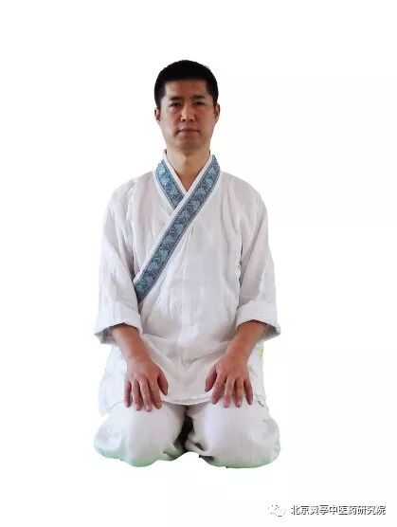
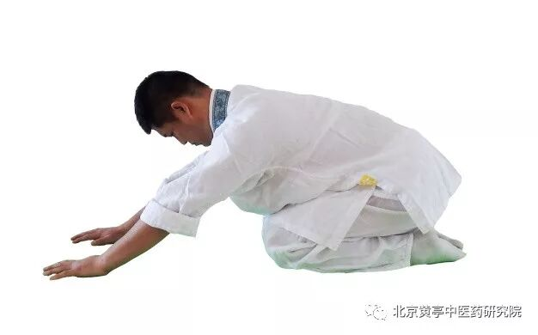
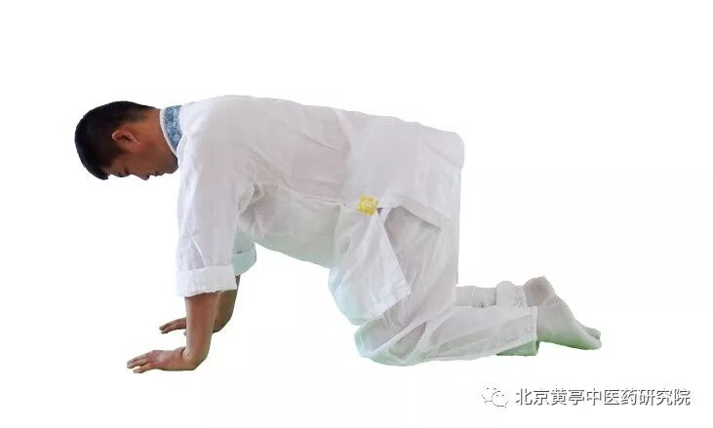
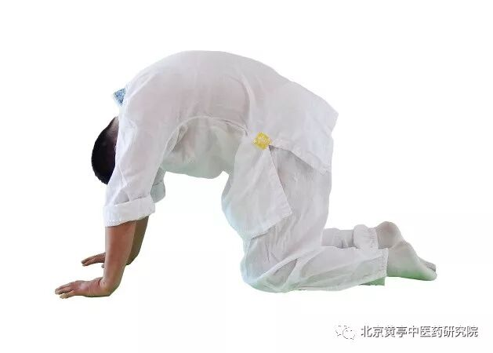
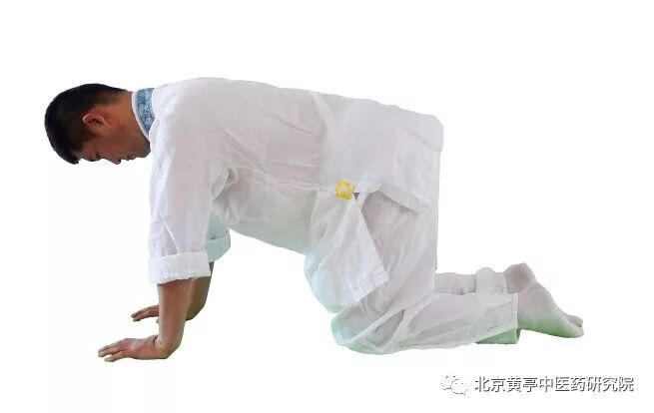
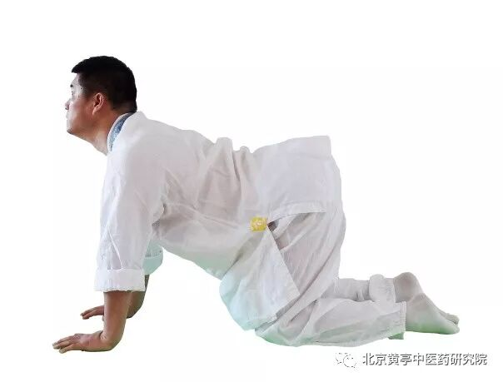
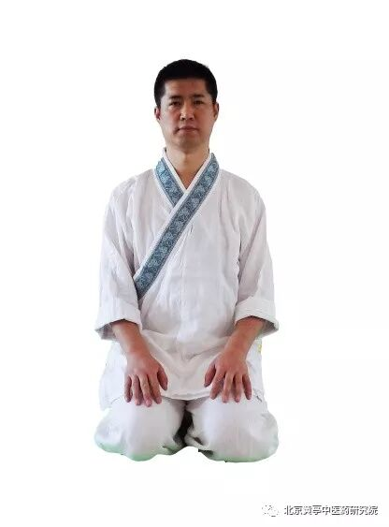
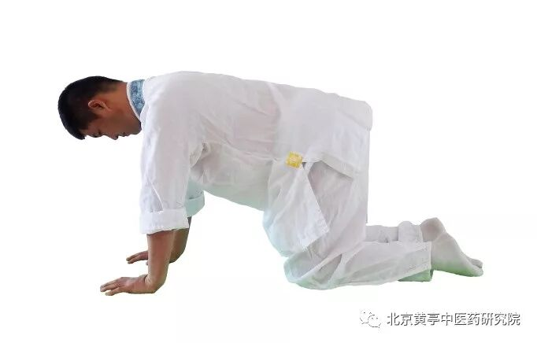
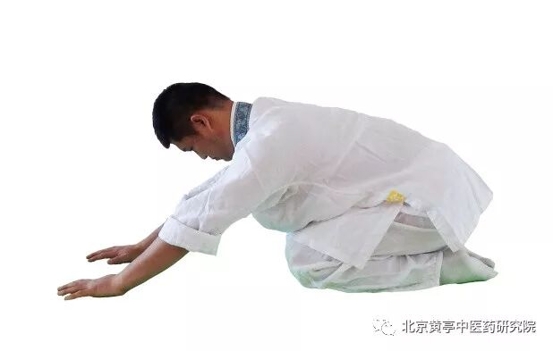
1.立秋缩身拱背式 Lìqiū suōshēn gǒngbèi shì Start of Autumn – Contract the Body and Arch the Back

Slide 41
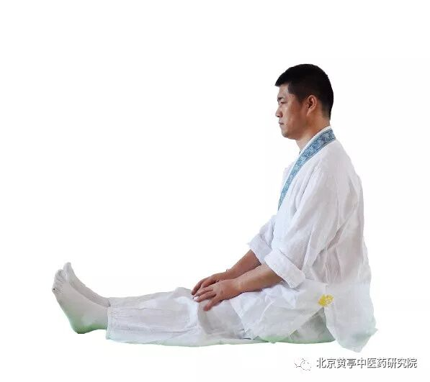
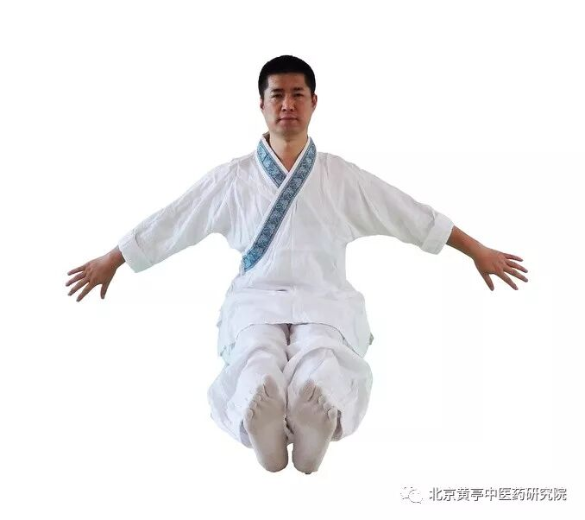
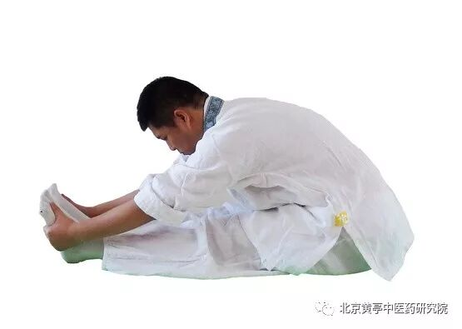
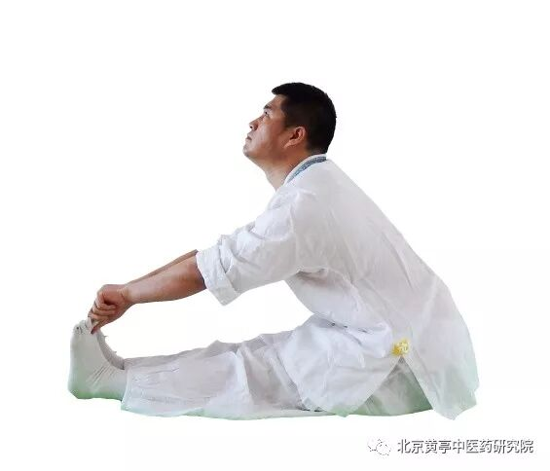
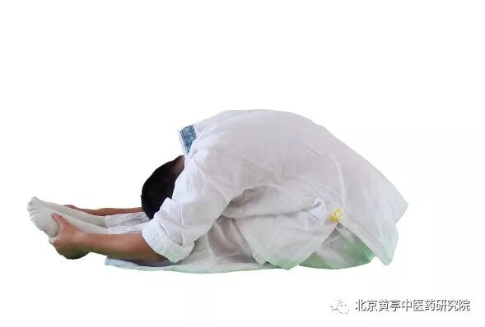
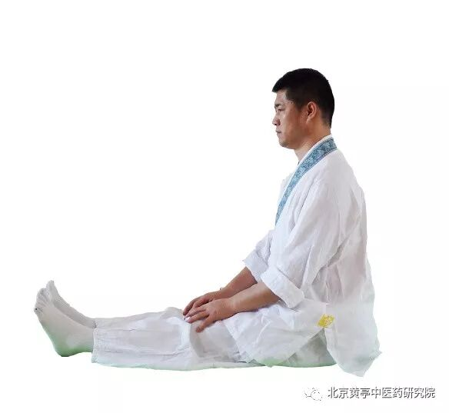
6. 霜降两手攀足式 Shuāngjiàng liǎngshǒu pānzú shì Frost’s Descent – Two Hands Grasp the Feet

Slide 42
Week 7
Tai Chi Movements 8
1 Winter Movement

Slide 43
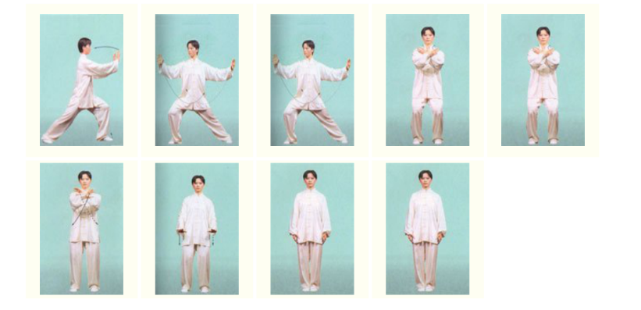
Illustration of the eighth movement十字手Cross hands.

Slide 44
Practice tips for Move 8 十字手 Shízì Shǒu – Cross Hands
Key Points
After Push, shift weight back, draw hands inward, and cross wrists in front of the chest.
Hands form a gentle cross (like the character 十), symbolizing closure and gathering energy.
The body settles, breathing calms; awareness returns to the centre (丹田).
Intended Benefits
Serves as a closing and centring posture.
Reinforces symmetry and balance.
Promotes inner stillness and consolidation of energy after expression.
Now, let’s put all the moves together and go over it a few times.

Slide 45
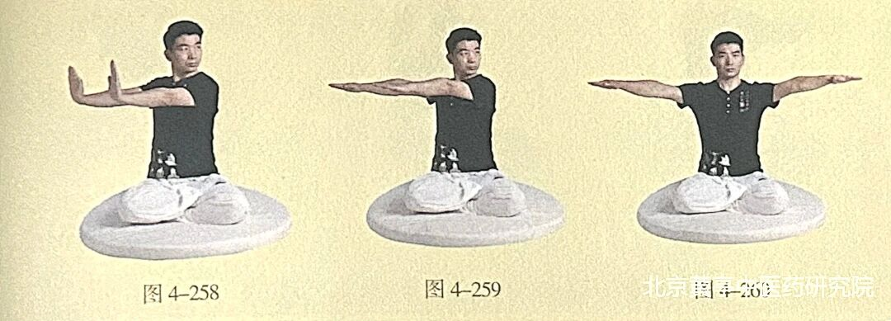
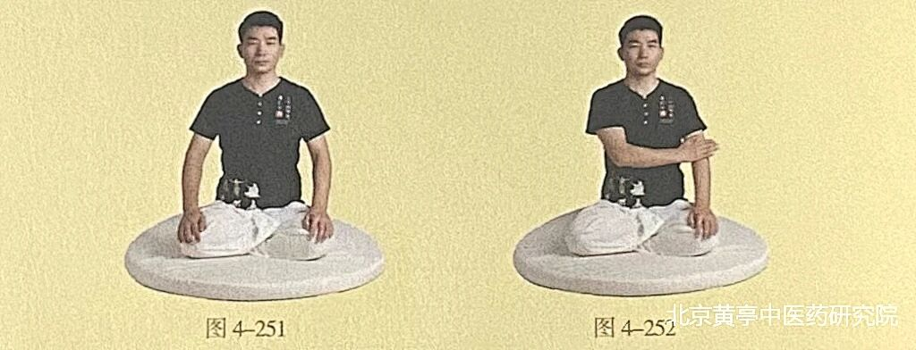
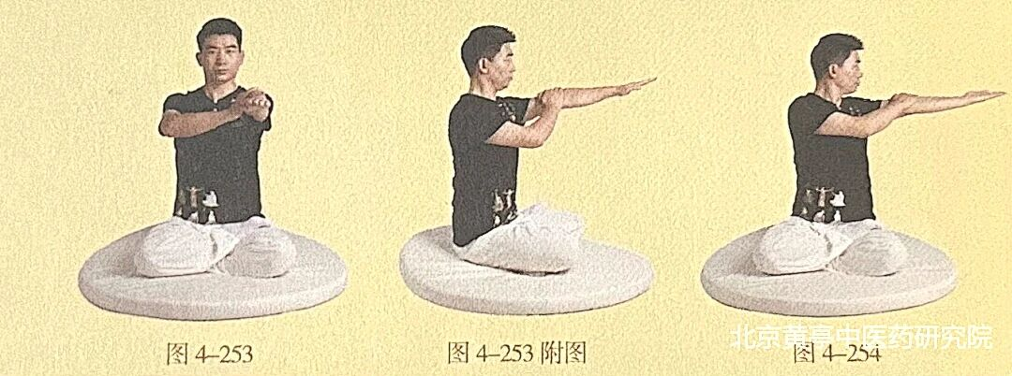
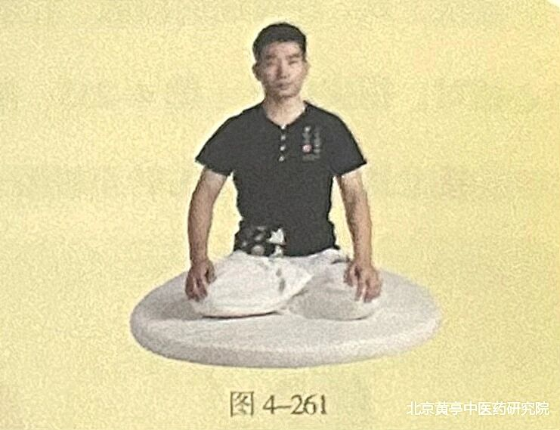
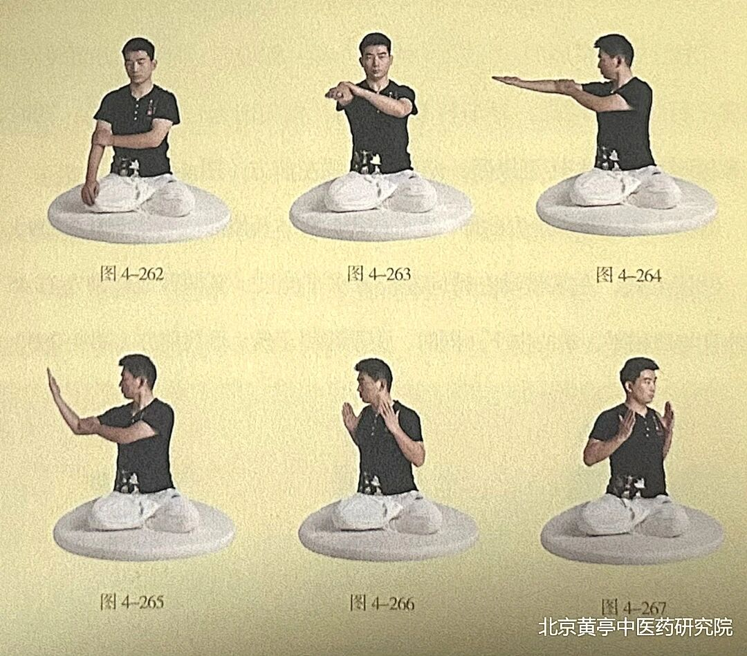
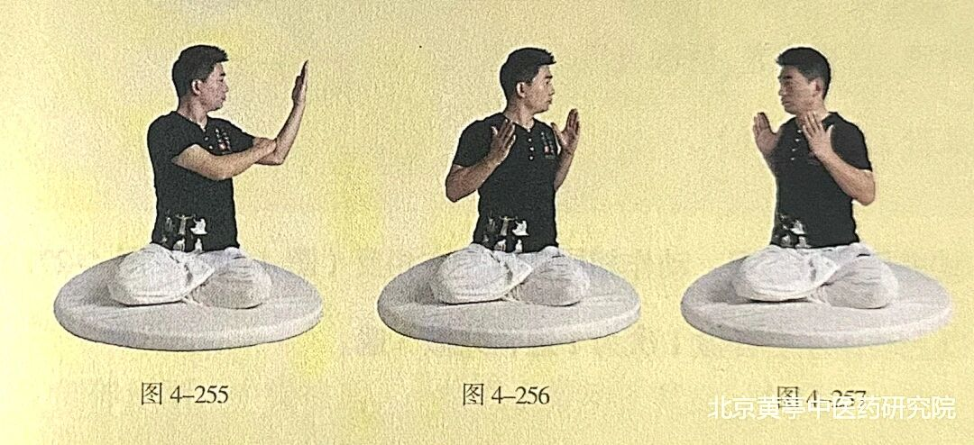
1.立冬挽肘侧推式 Lìdōng wǎn zhǒu cè tuī shì Beginning of Winter: Elbow Draw and Side Push

Slide 46
Week 8
8 Tai Chi Movements Revision
2 Winter Movements

Slide 47
1.立冬挽肘侧推式 Lìdōng wǎn zhǒu cè tuī shì Beginning of Winter: Elbow Draw and Side Push

Slide 48
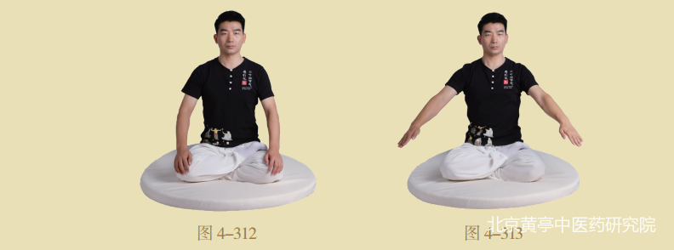




5. 小寒只手擎天式 Xiǎohán zhī shǒu qíng tiān shì Minor Cold: One-Hand Lifts the Sky

Slide 49






Key acupoints

Slide 50
Practice Makes Perfect
YouTube demonstration of a couple mirroring the routine:
https://www.youtube.com/watch?v=lH4JZ6aqCbA
What would you like to practice after the current course ends on 3rd of August?
Please give us your feedback. Check your email as OU has sent you a link for a short questionnaire.
To deepen your understanding of the 24 Solar Terms, a UNESCO Intangible Cultural Heritage, and to continue your practice of the seasonal meditation routine 24节气中医导引养生法, check out the project website: https://www.the24solarterms.com where you will find lots of discussion and YouTube links. You are warmly welcome to join and share your observations, reflections and creations related to the changing seasonalises.
For more Tai Chi and Qigong practice, learn different routines to suit different interests and varying levels of strength and flexibility, contact: Yutaichi4you@gmail.com

