Slide 1
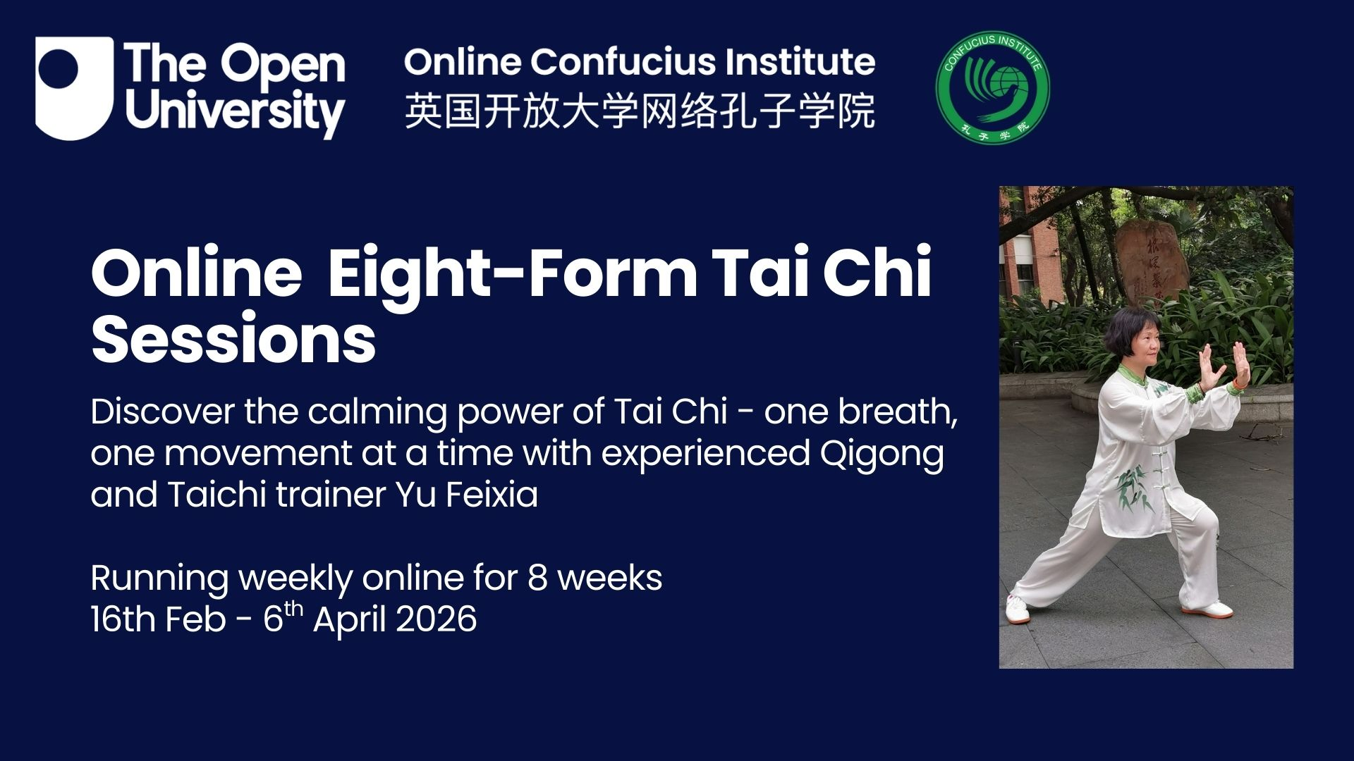

Slide 2
Recap of Week 5 7th Movement in Taichi Grasp the peacock's tail Spring Solar Term Daoyin: 惊蛰握固炼气式 Awakening of Insects: Wogu to Cultivate Qi 春分排山推掌式 Spring Equinox: Pushing Mountains with Palms Content of Week 6 8th Movement in Taichi Cross Hand Autumn Solar Term Daoyin 立夏足运太极式Beginning of Summer: Tai Chi Foot Circulation 小满单臂托举式 Small fullness: Single-Arm Upward Lift

Slide 3
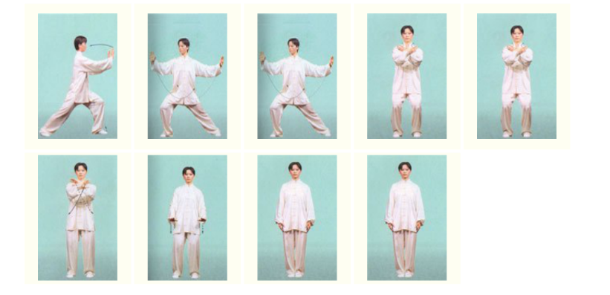
Week 6 Illustration of the eighth movement十字手Cross hands

Slide 4
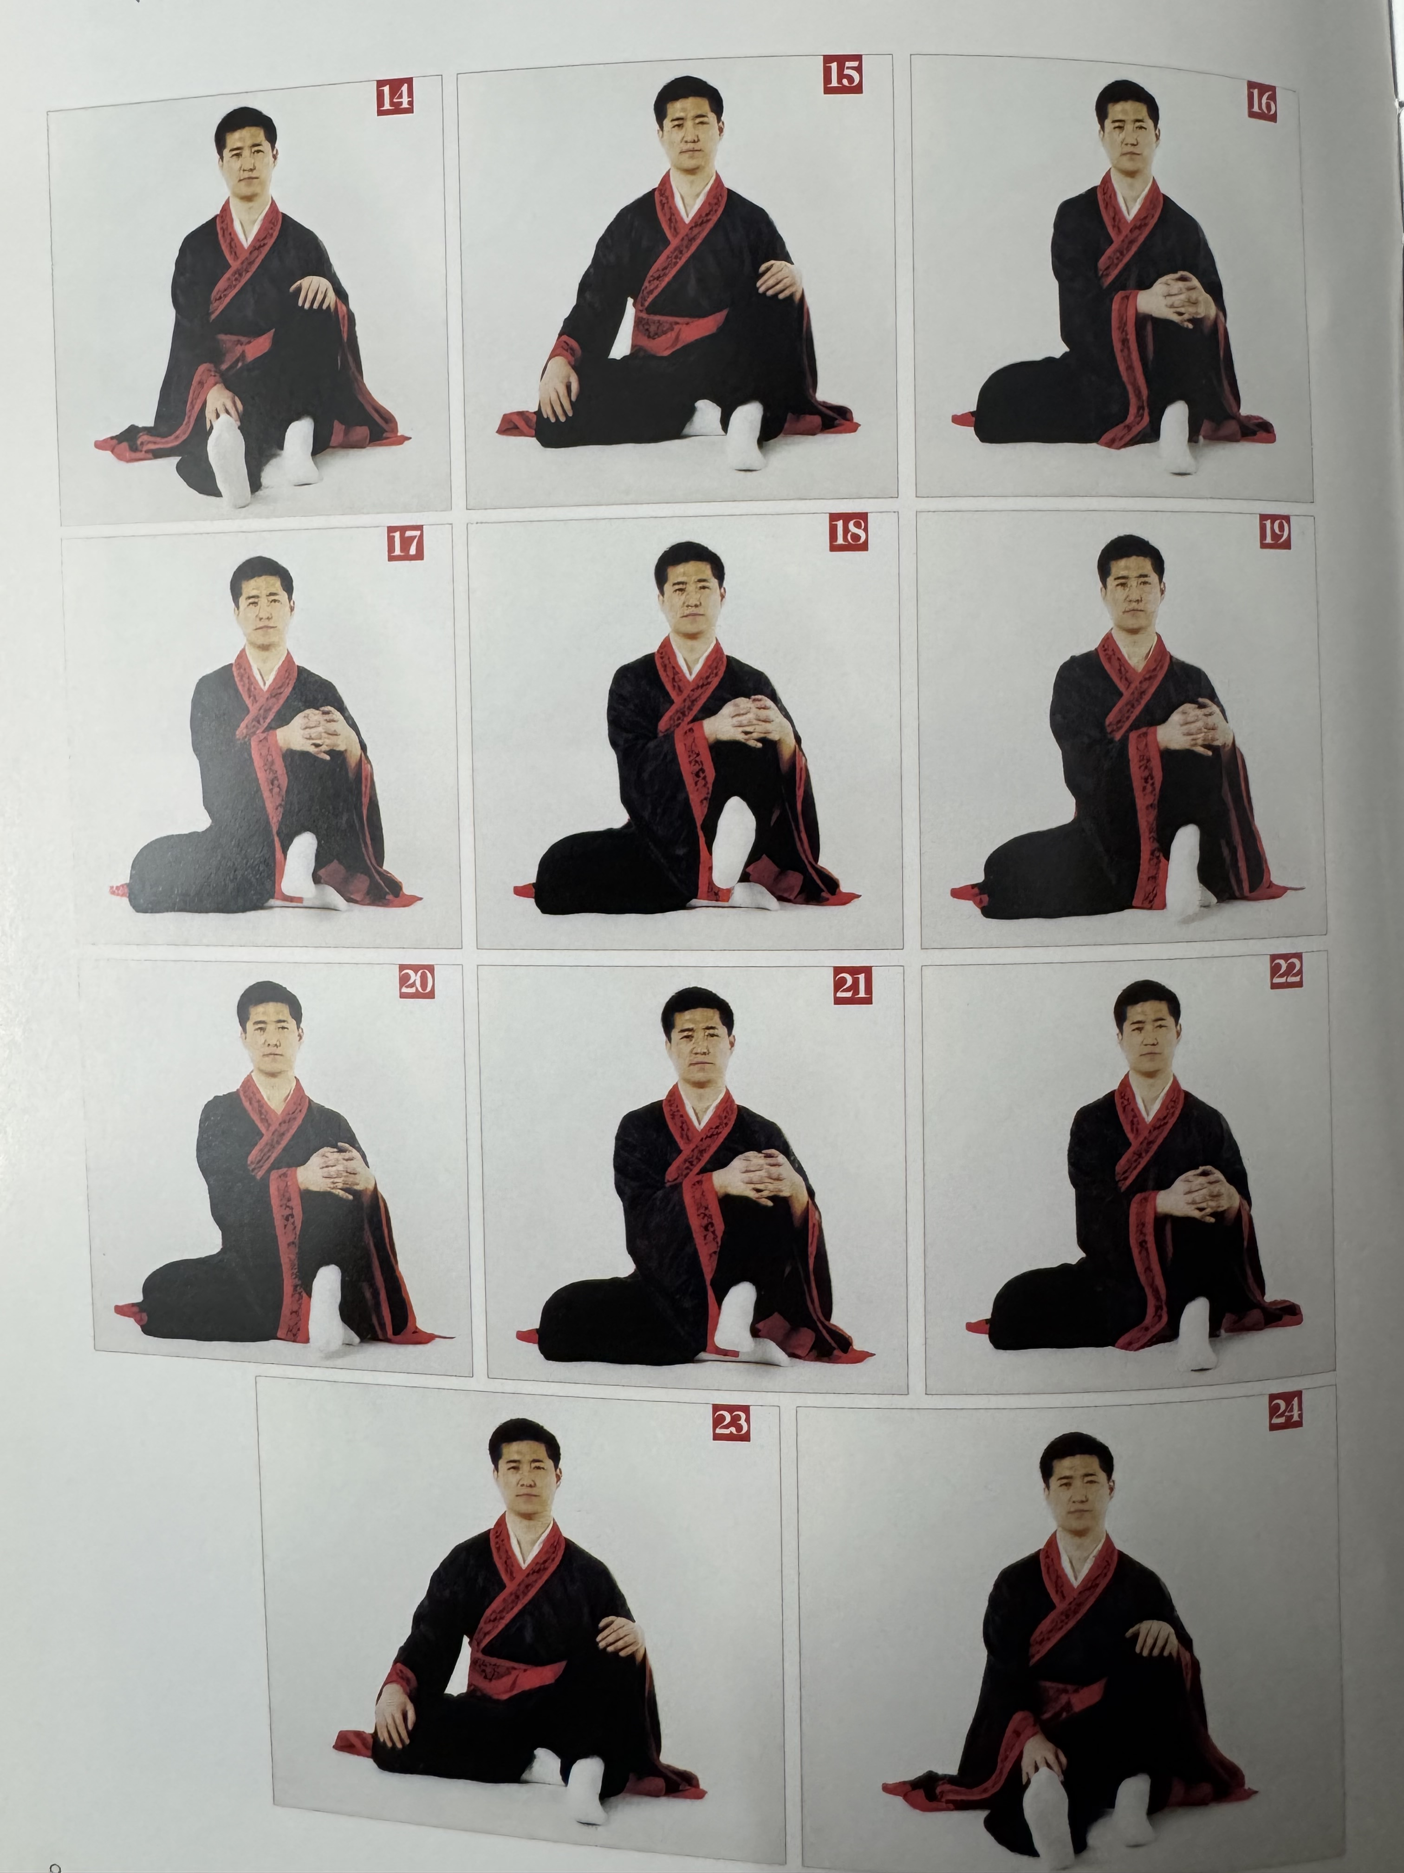
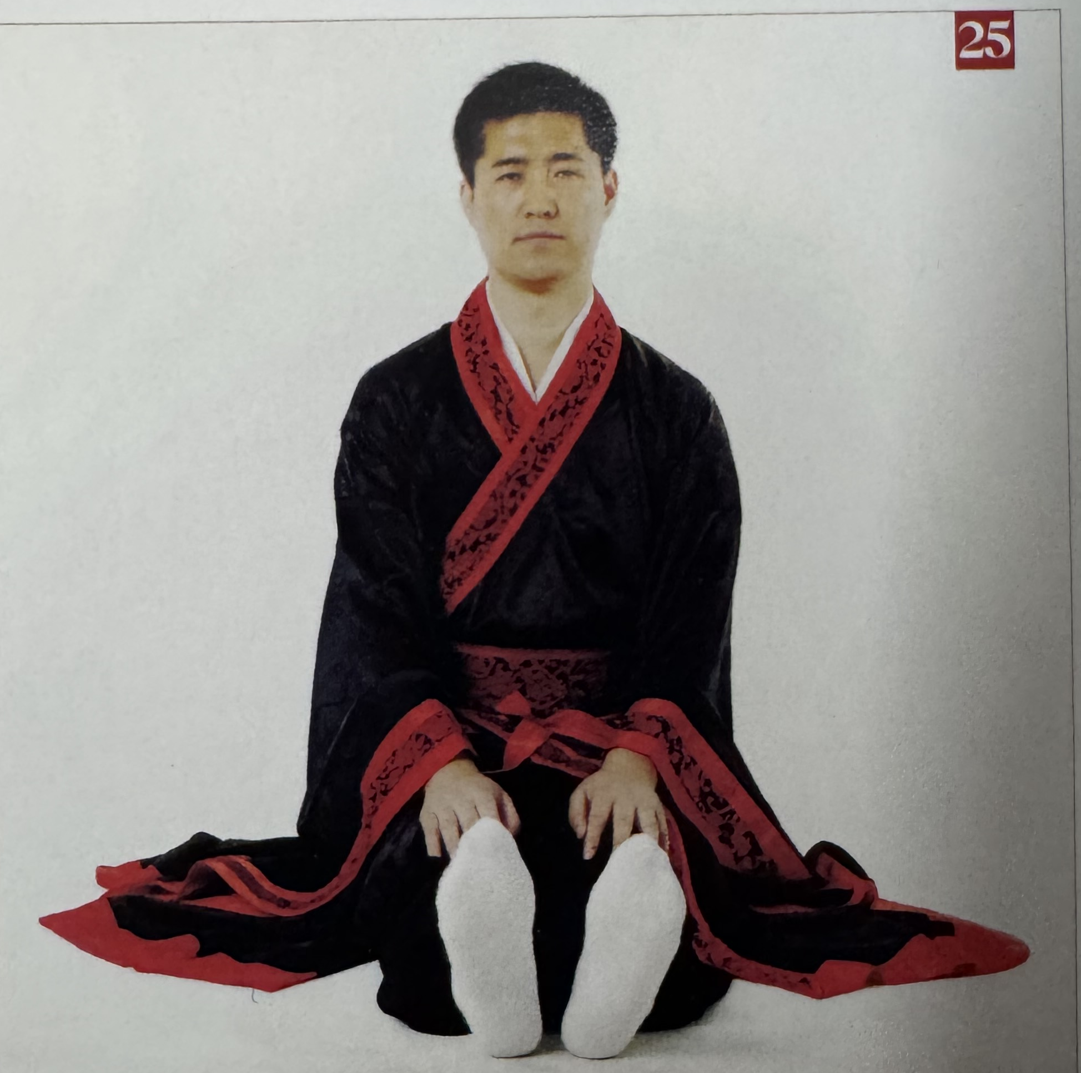
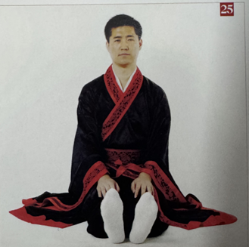
1 立夏足运太极式 Lìxià zú yùn tàijí shi Beginning of Summer: Tai Chi Foot Circulation
This group depicts the mirror images of circling the left ankle.
In TCM, feet are seen as the second heart of our body. Summer is the season of the heart.

Slide 5
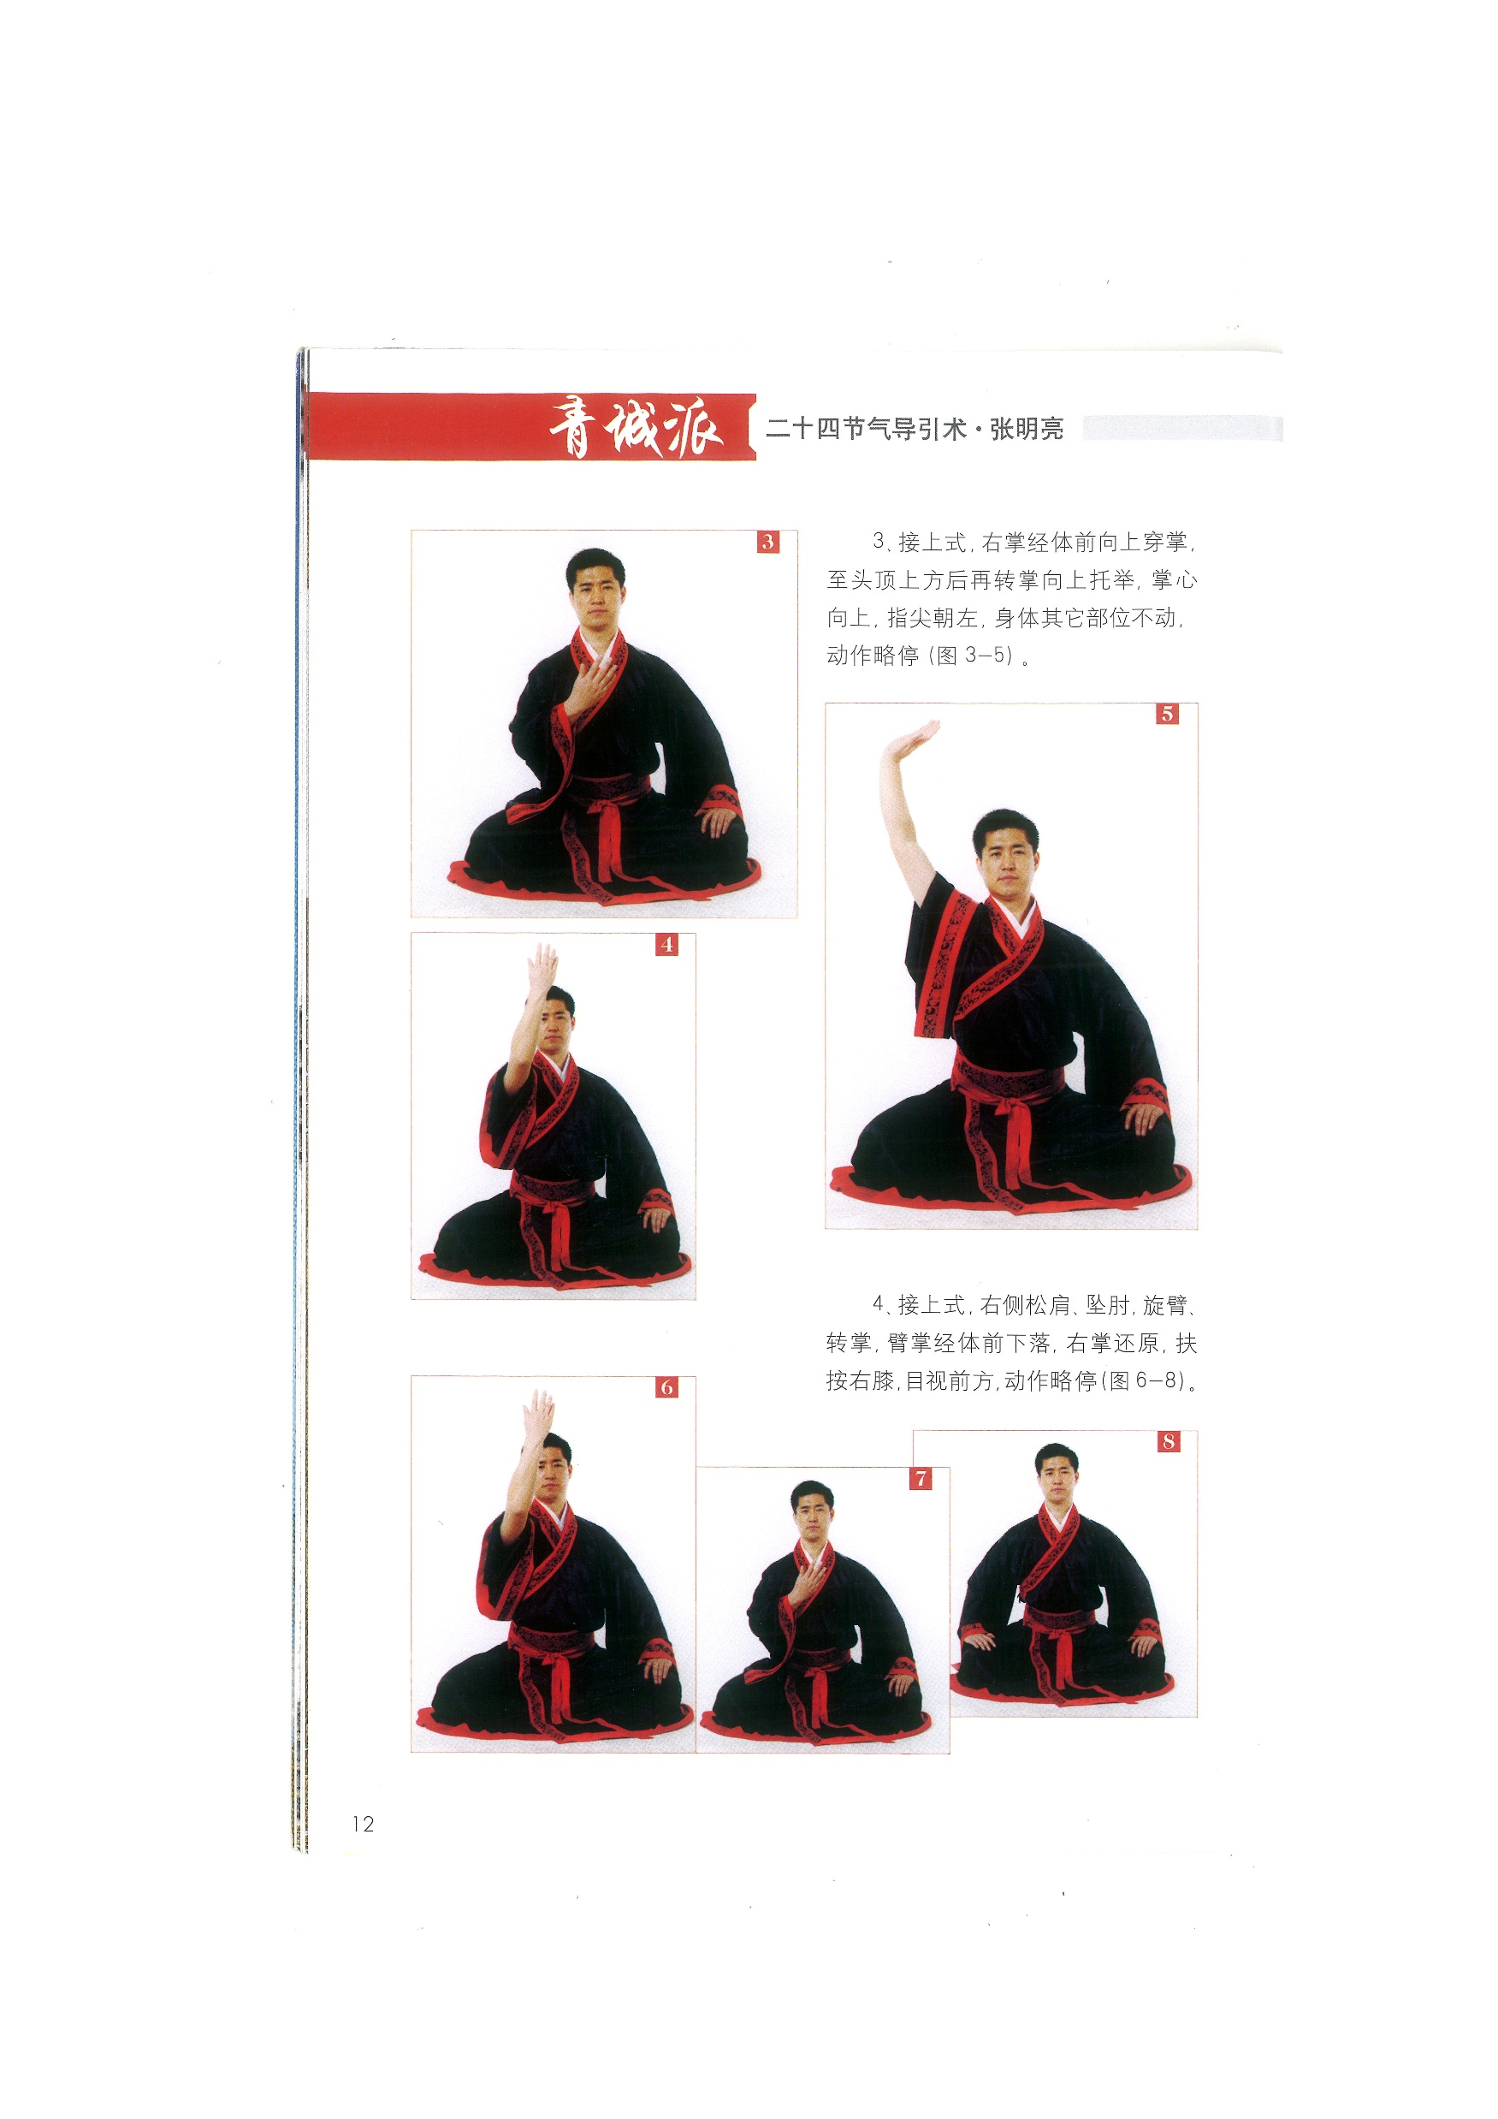
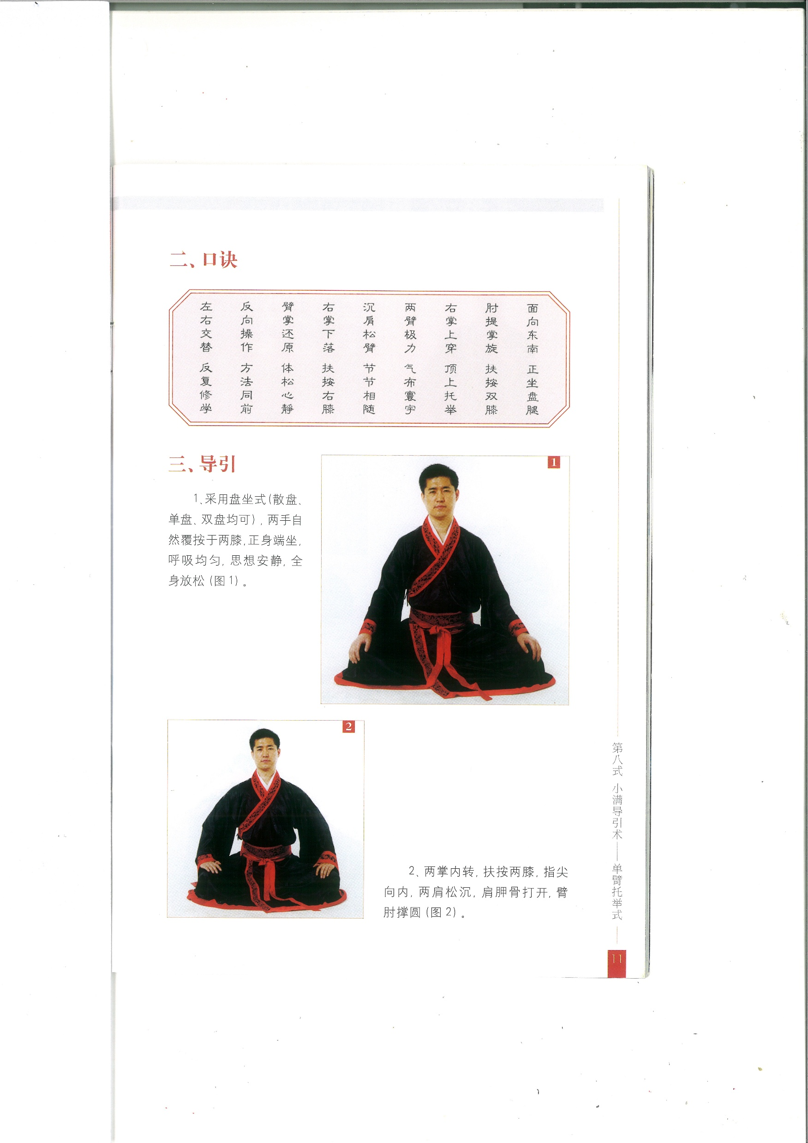
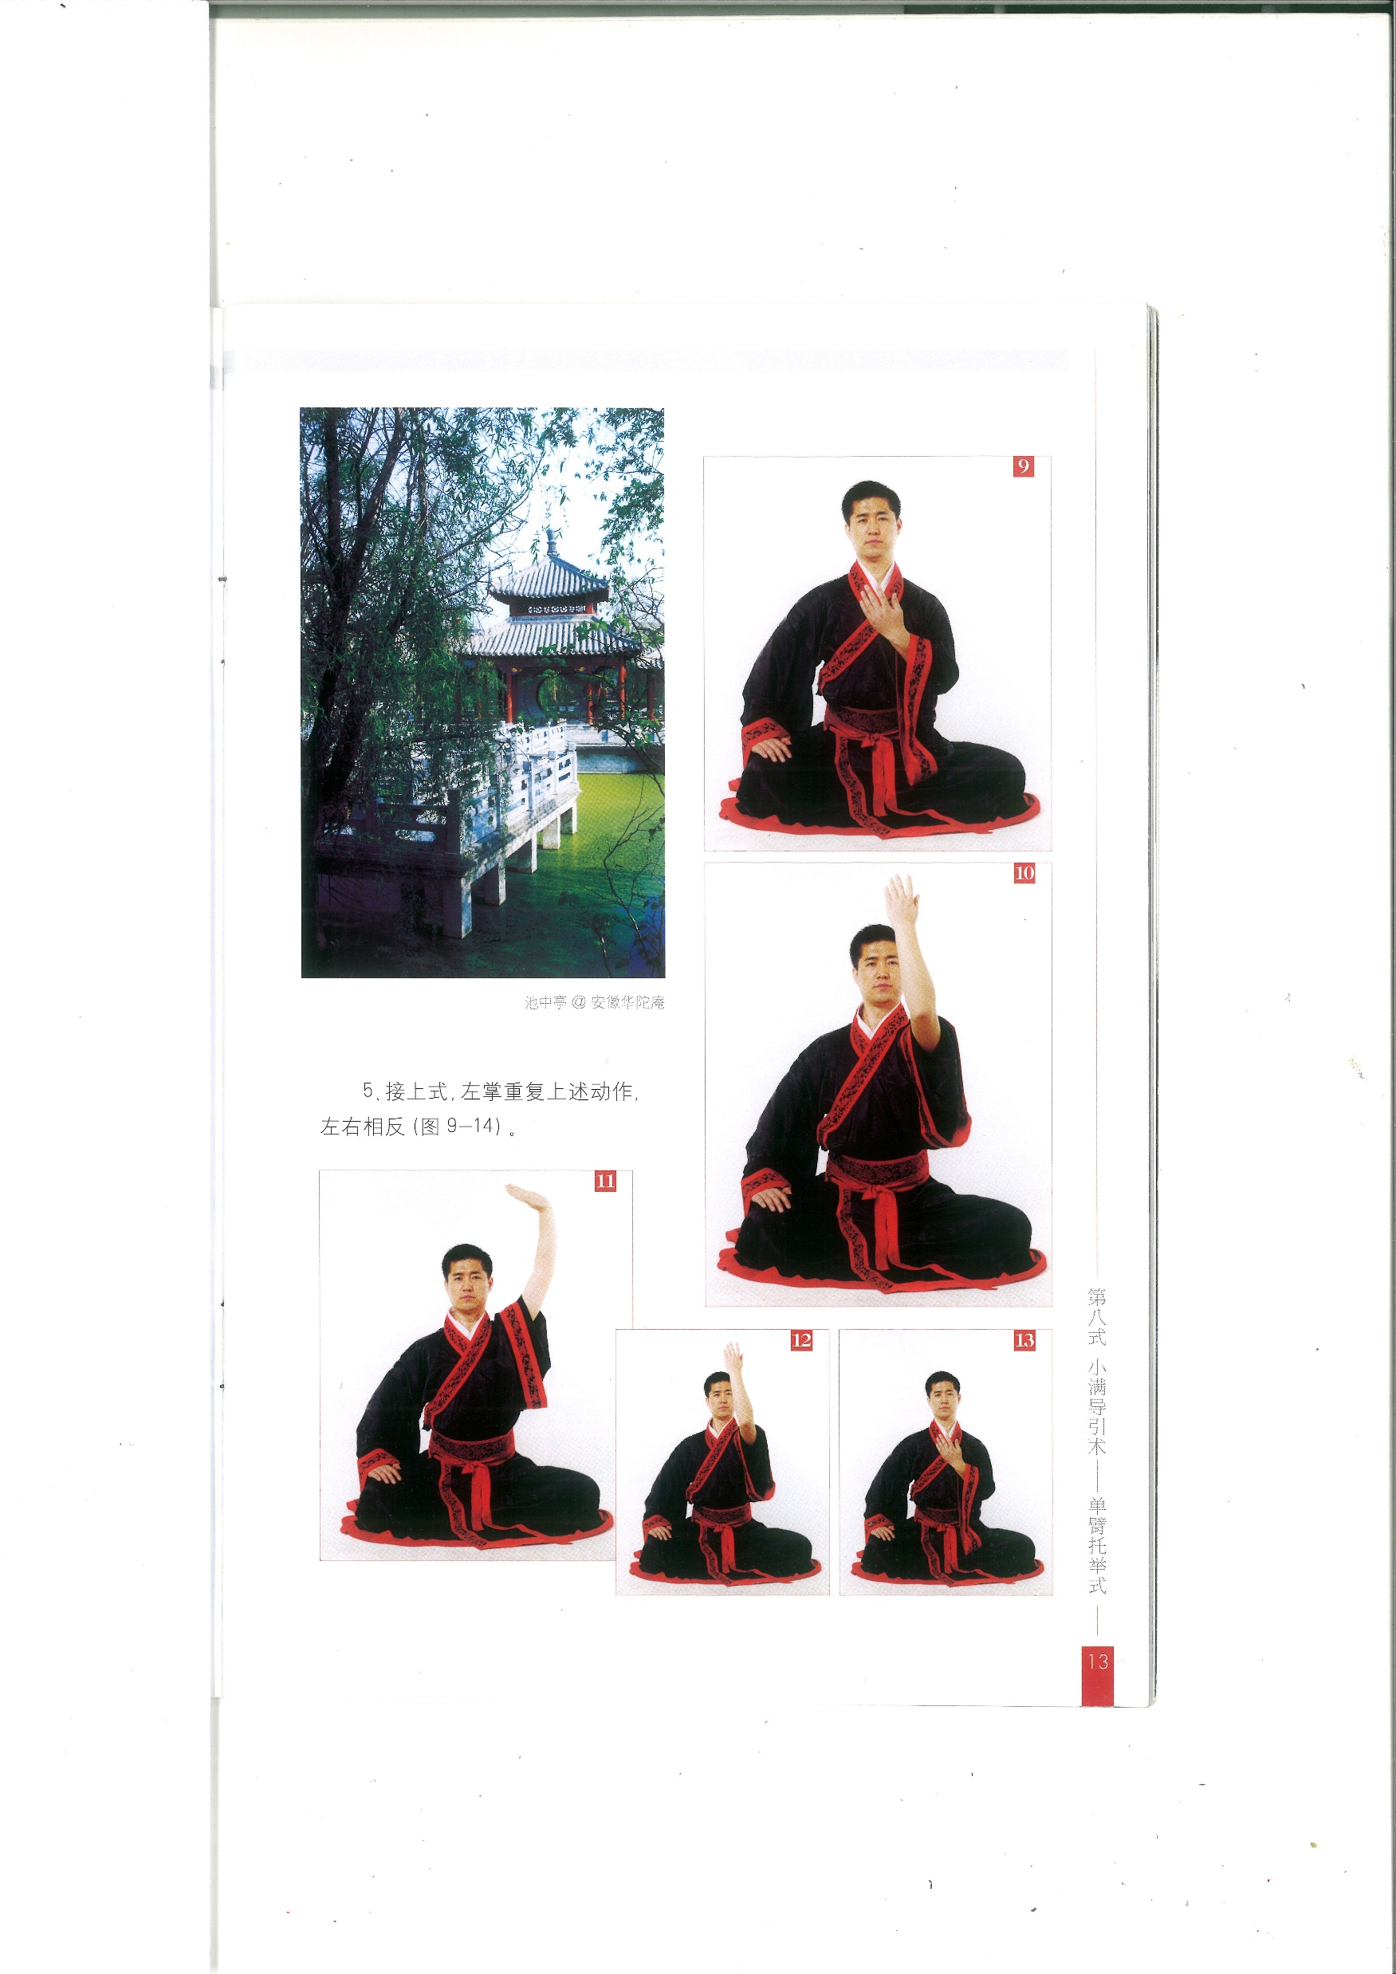
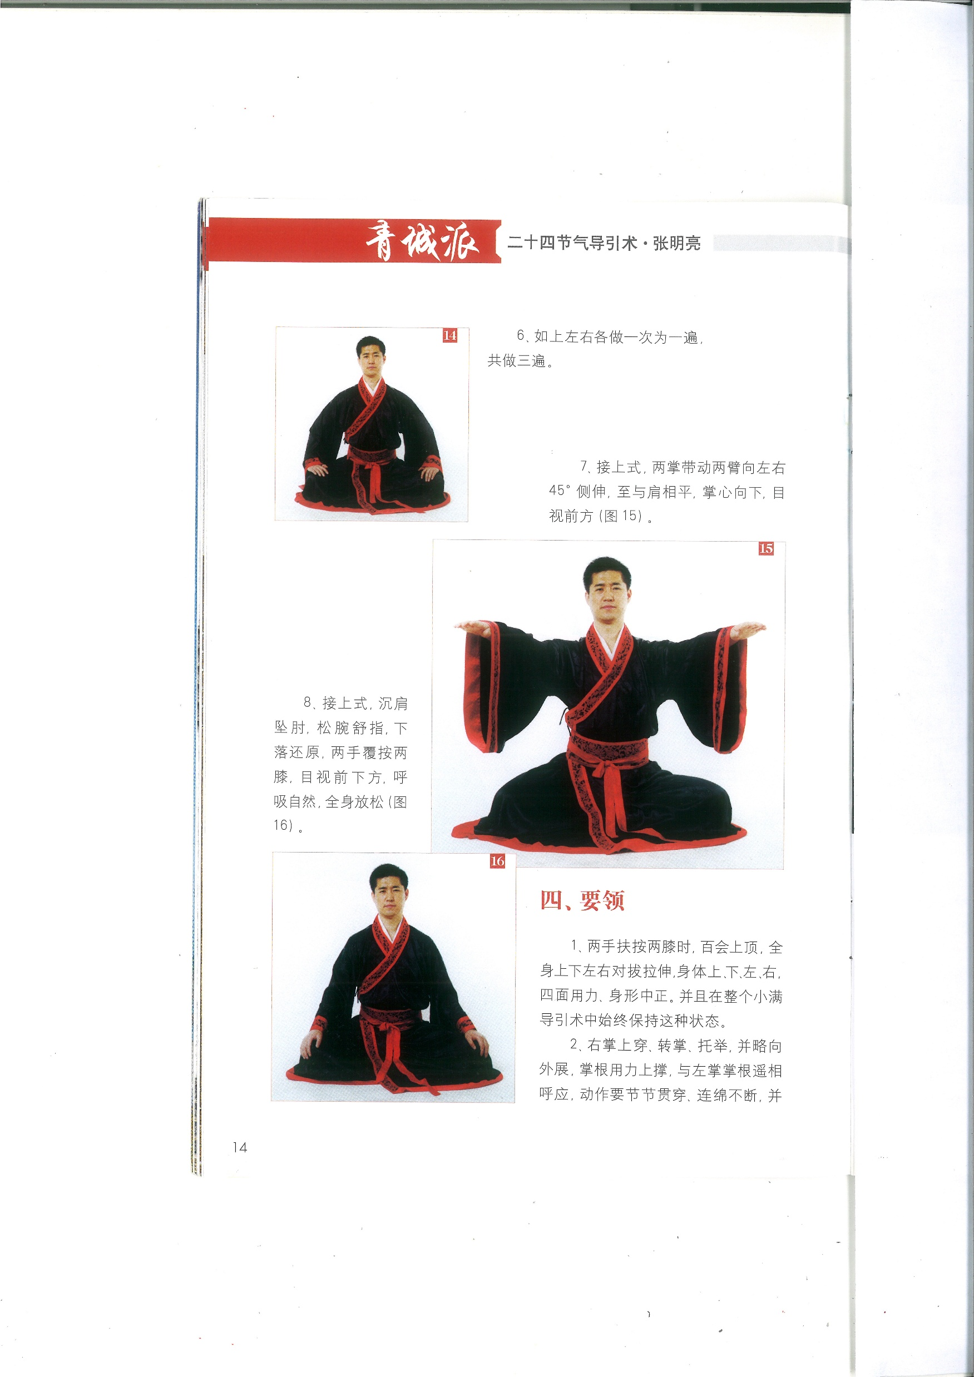
2.小满单臂托举式 Xiǎomǎn dān bì tuō jǔ shì Small fullness: Single-Arm Upward Lift

Slide 6
Additional classes if you are interested
Daoyin for 24 Solar Terms
Saturday 1:00-2:00pm on alterative weeks,
next one on 21st of March
Body-Mind Form from Zhineng Qigong System
Saturday 1:00-2:00pm on alterative weeks,
Next one on 28th of March
This forms part of my research project, so it is totally free to join, donations are welcome, Join Zoom Meeting
https://us02web.zoom.us/j/85198148219?pwd=vcxd96PsiBeaY9vXxfTSZULypvDMBy.1
Meeting ID: 851 9814 8219
Passcode: Research26

