Slide 1
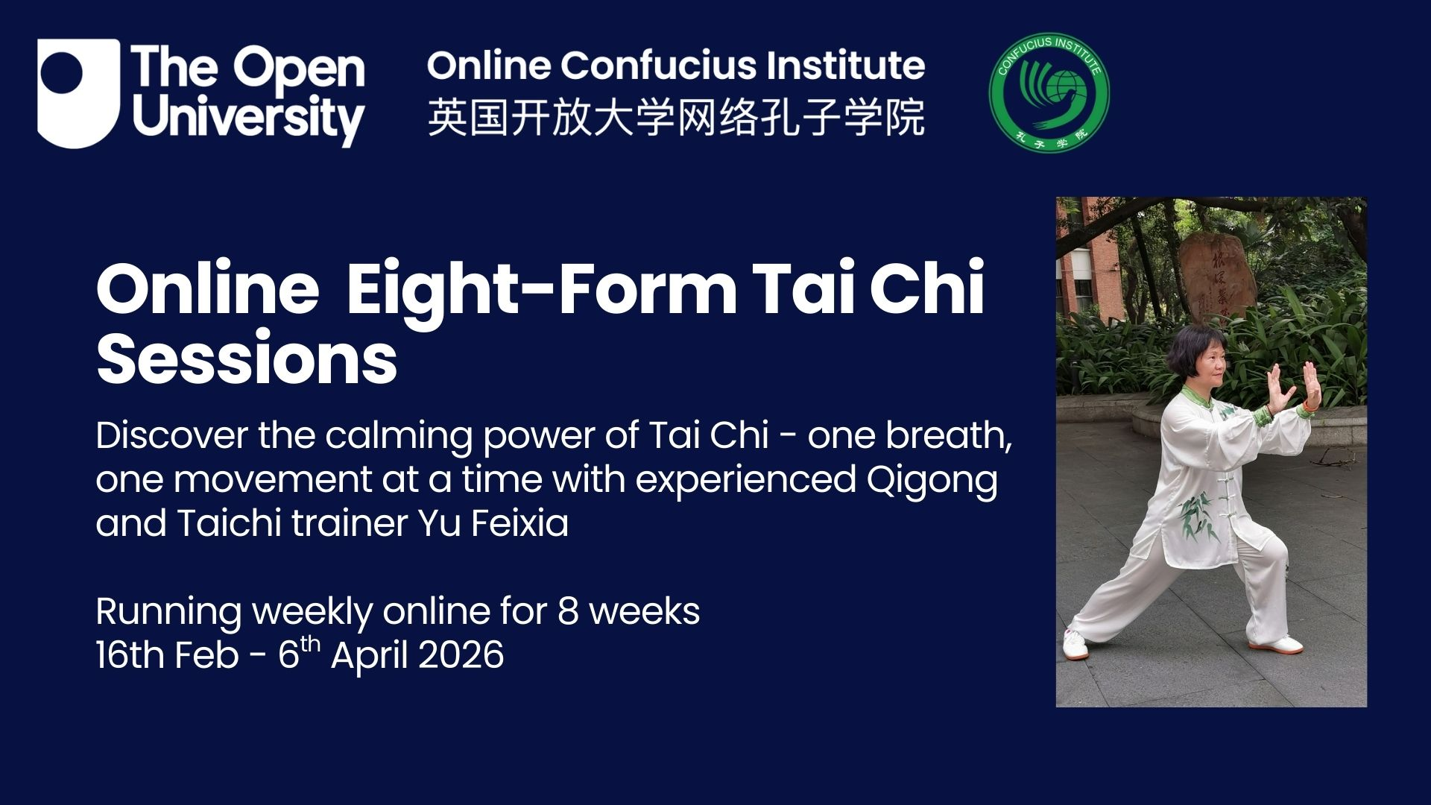

Slide 2
End of course survey
Some of you might have already received the end-of-course questionnaire. If you did not register last week, you would receive it today or tomorrow. Please respond and tell us what you would like us to do, to change and to add.
More importantly, please tell me if you are willing to be interviewed regarding doing Taichi and Qigong, any physical or mental changes you have noticed since you started the course and if the course has changed your perception of Chinese health enhancement tradition and practice, your perception of gentle body-mind practice and what, if you wish to learn more: 24-Movement Taichi or TCM Daoyin for 24 Solar Terms

Slide 3
Recap of Week 7
Full sequence of 8-Movement Taichi 八式太极拳
Autumn Solar Term Daoyin
秋分掩耳侧倾式Autumn Equinox – Cover the Ears and Tilt the Body Sideways
寒露托掌观天式 Cold Dew – Lift the Palms and Gaze at the sky
This week’s content:
Revision of the full routine
Winter Solar Term Daoyin
小雪蛇行蛹动Minor Snow: Snake-Crawling Cocoon Movement
冬至升嘶降嘿式 Winter Solstice: Rising “Si” and Descending “Hei” Breath

Slide 4
The names of the movements in 8-Movement Taichi are:
预备势: Preparation
起势: Opening
1、 卷肱势 Reverse forearms.
2、 搂膝拗步Brush knee push hand.
3、 野马分鬃 Part the wild horse's mane.
4、 云手Cloud hands.
5、 金鸡独立 Golden rooster stands on one leg.
6、 蹬脚 Kick with Heel.
7、 揽雀尾Grasp the peacock's tail.
8、 十字手Cross hands.
收式： Closing

Slide 5
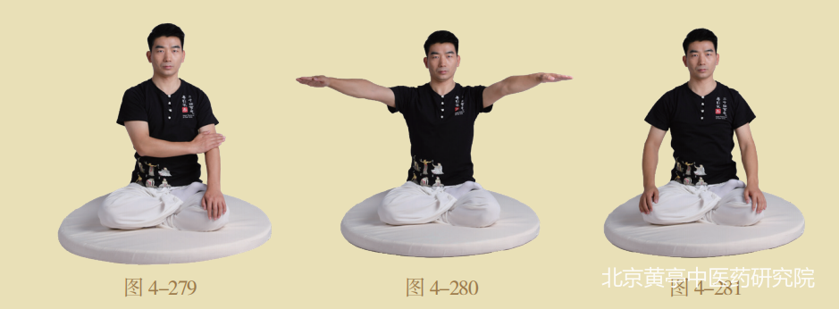
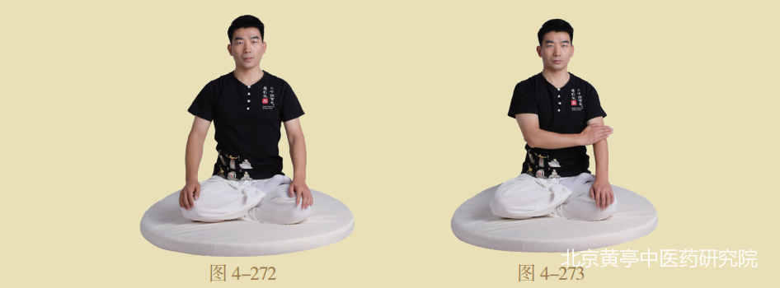
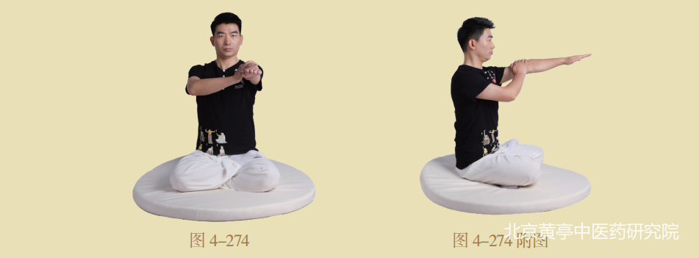
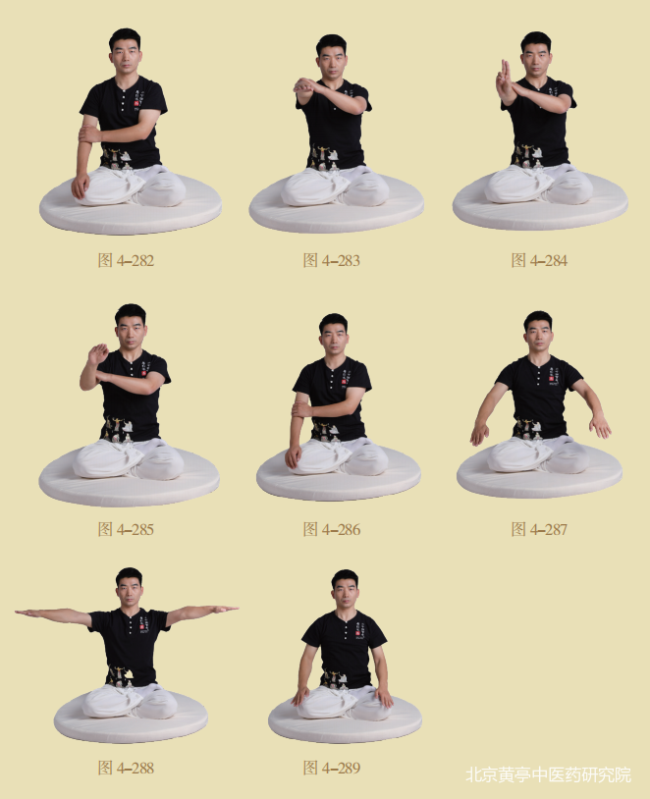
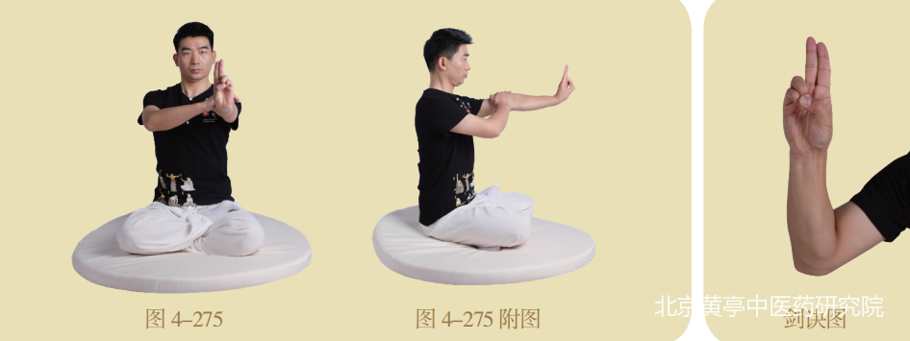
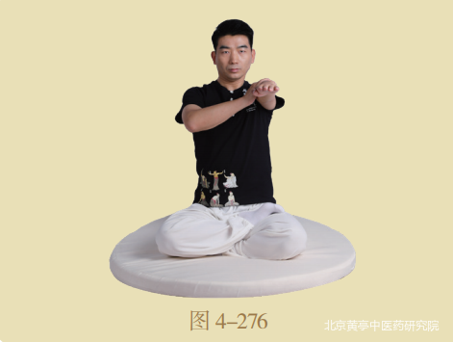
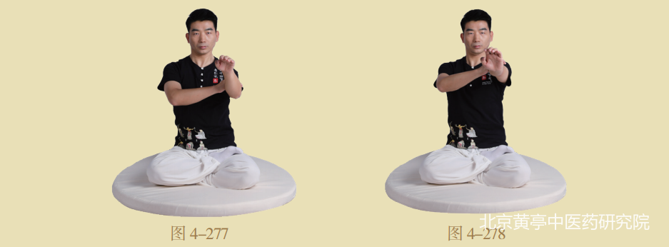
2.小雪蛇行蛹动式 Xiǎoxuě shé xíng yǒng dòng shì Minor Snow: Snake-Crawling Cocoon Movement

Slide 6
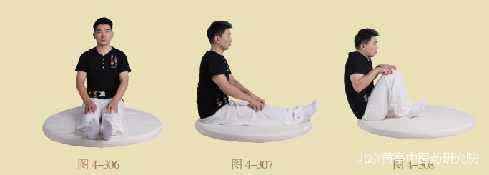
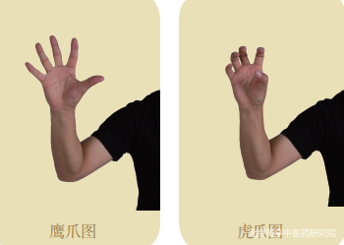
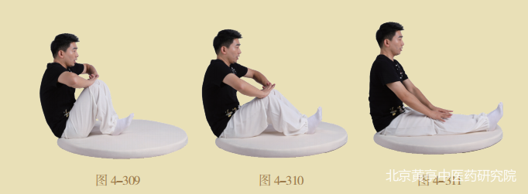
4. 冬至升嘶降嘿式 Dōngzhì shēng sī jiàng hēi shì Winter Solstice: Rising “Si” and Descending “Hei” Breath

Slide 7
Additional classes if you are interested
Daoyin for 24 Solar Terms
Saturday 1:00-2:00pm on alterative weeks,
next one on 18th of April,
Body-Mind Form from Zhineng Qigong System
Saturday 1:00-2:00pm on alterative weeks,
  Next one on 11th of April,
This forms part of my research project, so it is totally free to join, donations are welcome, Join Zoom Meeting
https://us02web.zoom.us/j/85198148219?pwd=vcxd96PsiBeaY9vXxfTSZULypvDMBy.1
Meeting ID: 851 9814 8219
Passcode: Research26

Slide 8
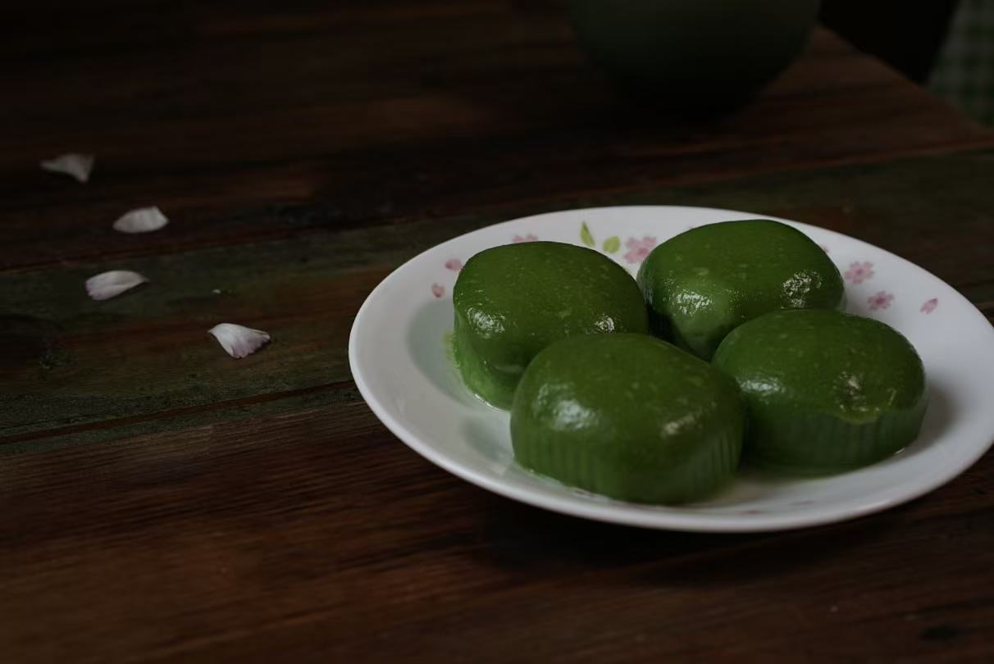
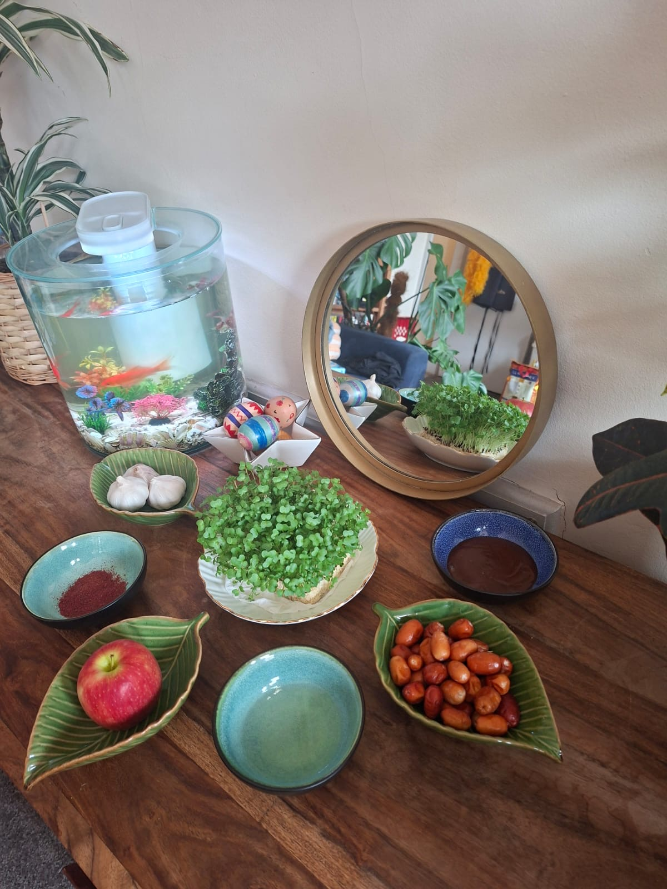
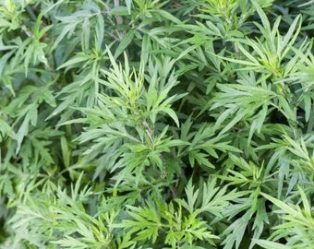
Marking sseasonality in different cultures

Slide 9
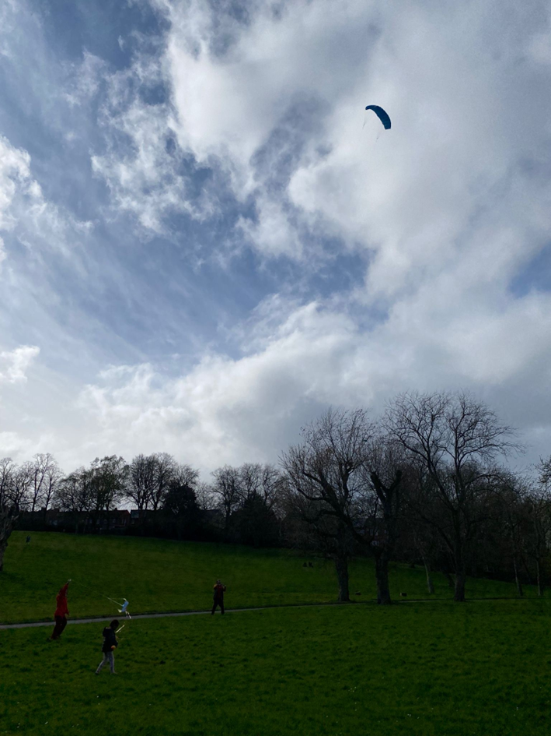
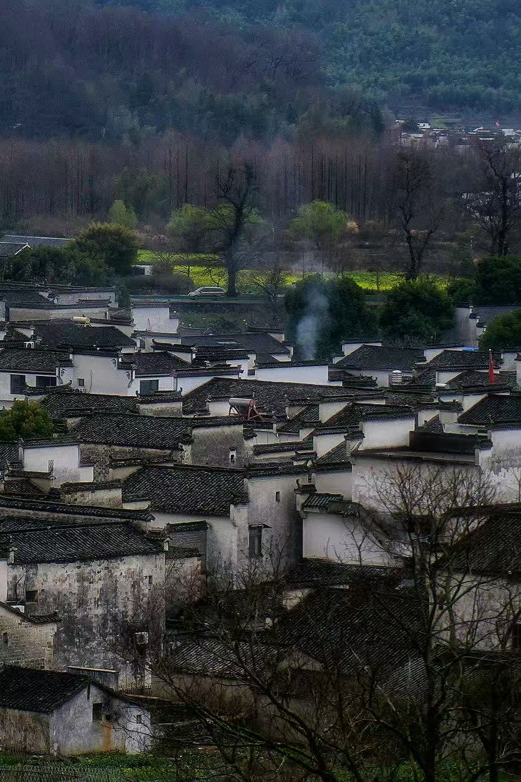
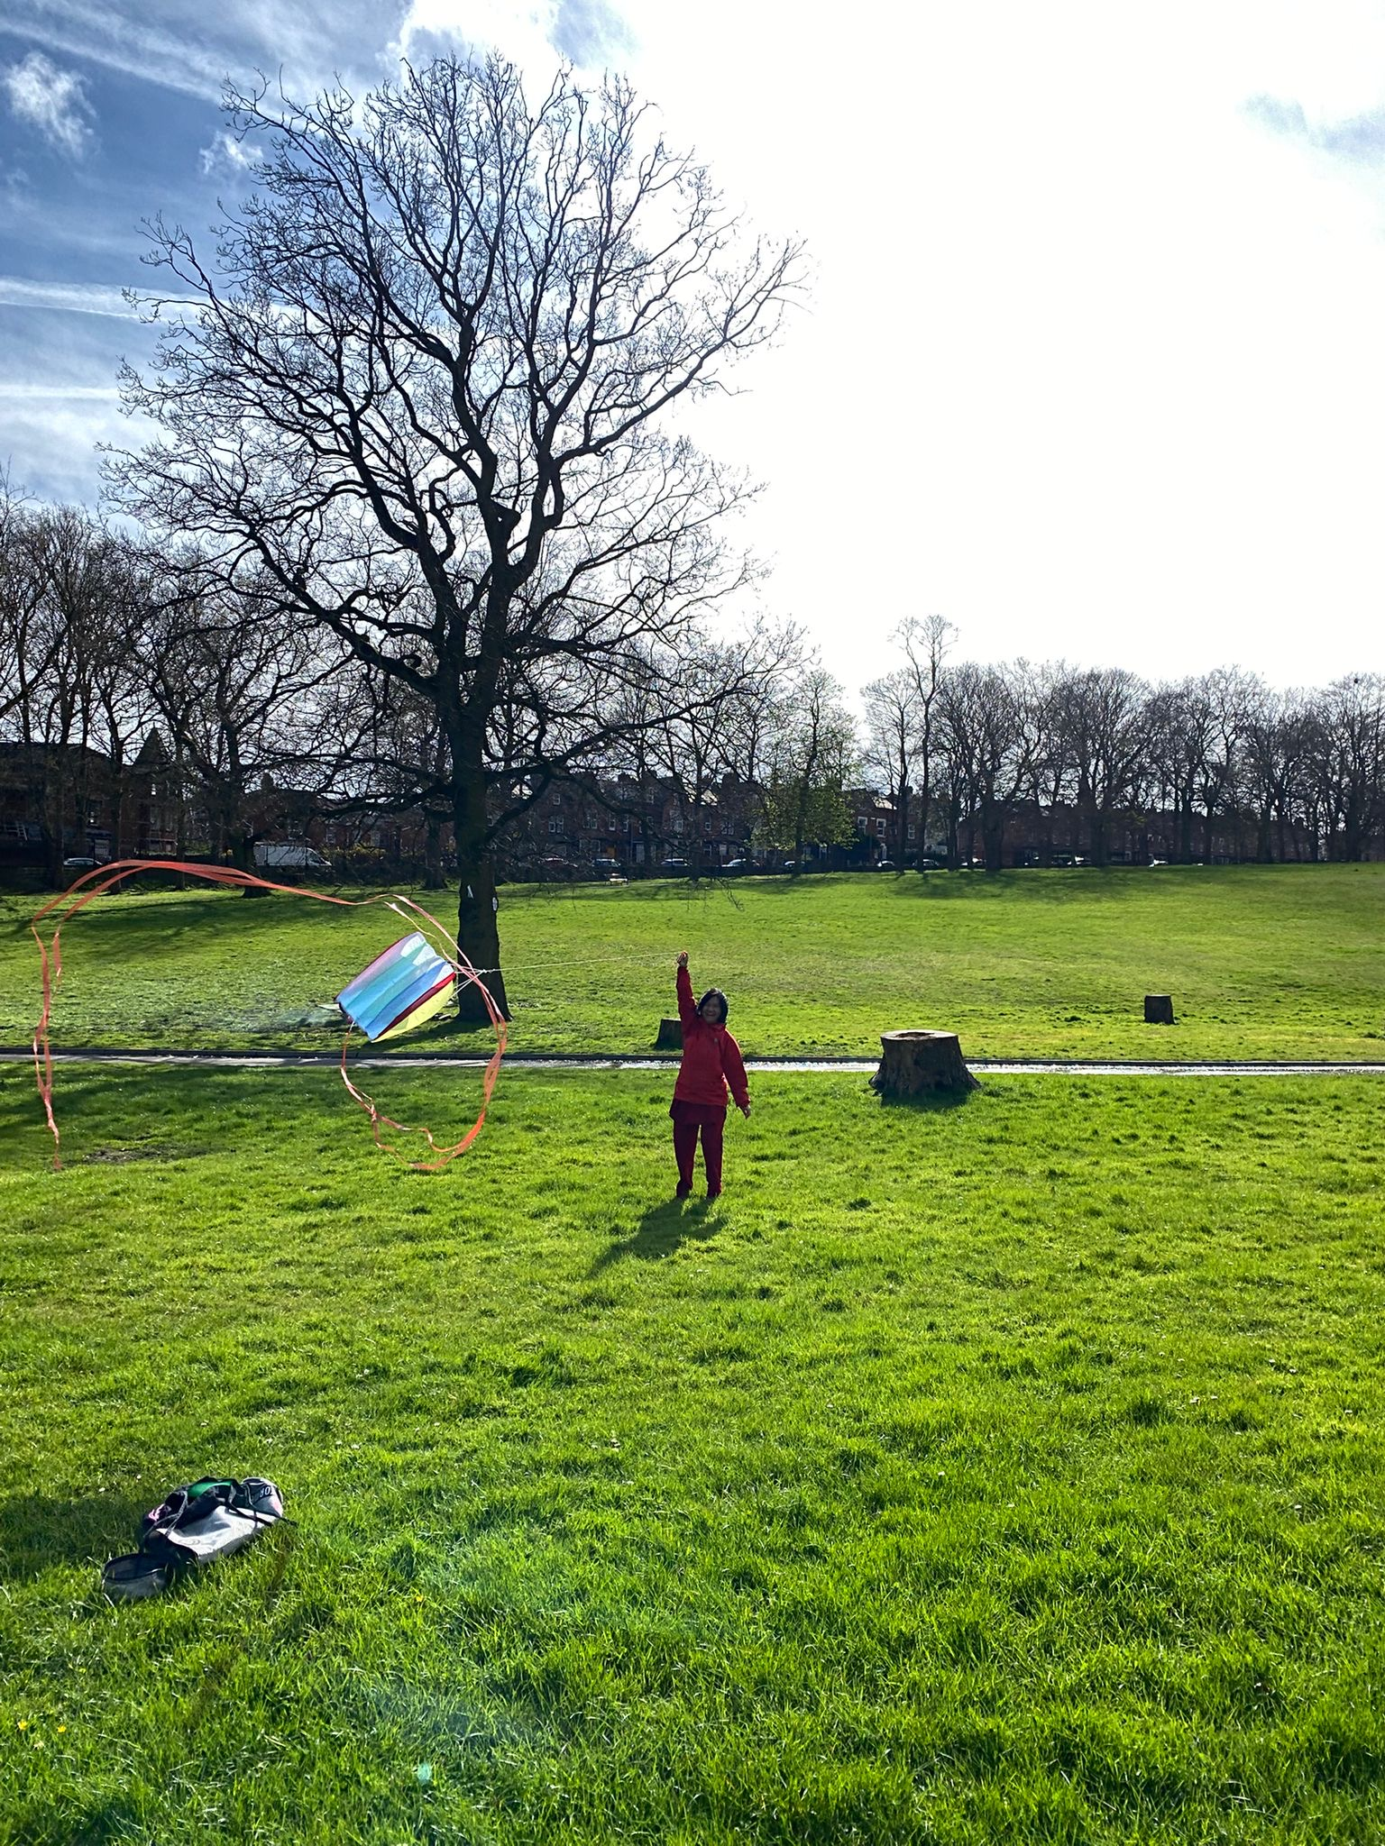
Marking sseasonality in different cultures

