Slide 1
Dynamic Qigong for Health - OU Staff Wellbeing Workshop
Feixia Yu
YuTaichi4You@gmail.com

Slide 2
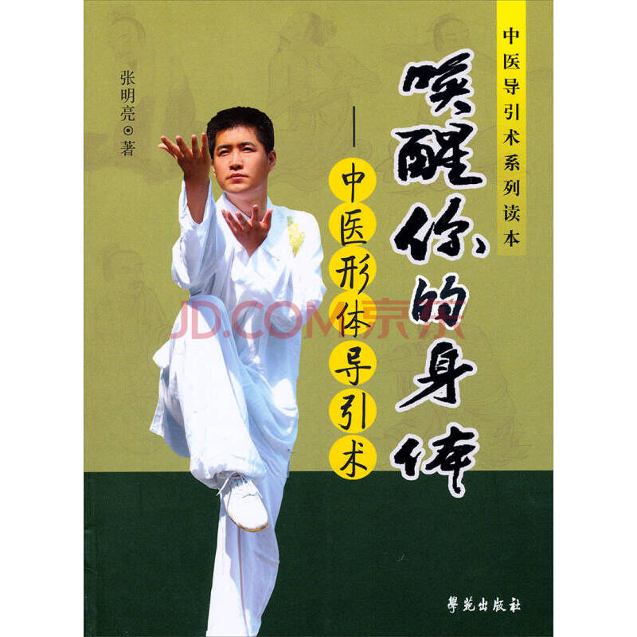
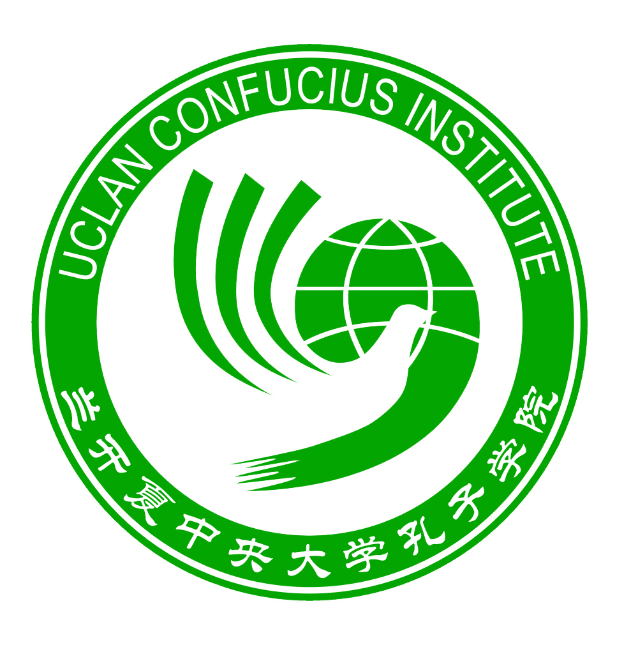
Warm up with Emei Shenzhangong 峨眉伸展功
Devised by Master Zhang Mingliang 张明亮
Very effective Daoyin routine
Based on Emei Tradition & solid TCM theory
Tried and tested by hundreds of thousands of followers
12 movements
Starts from head working downwards to feet
Very slow-paced and inward looking
Mindful to the body and energy flow
Short version of around 20 minutes with only one repetition
Ends with some breathing and cool down routines

Slide 3
Top tips for practicing dynamic Qigong
Four-character Golden Rules of Daoyin:
大 make movement as big as possible
慢 slow down as much as possible
停 pause and feel the stretch
观 observe energy flow when in stretch
在伸展中体会放松
experience relaxation (and softness) when the body is being stretched
在放松中进行伸展
stretch when the body (and the mind) is relaxed

Slide 4
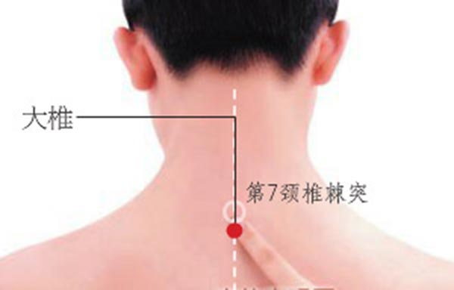
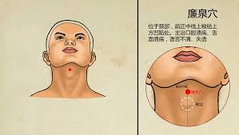
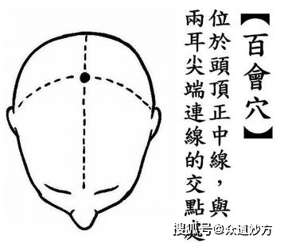
Movement 1：颈项式 Front & Back of Neck Stretches
鹤首 Crane head
Focusing font of neck
Working on Renmai, raise the Yin energy
龙头 Dragon head
Focusing on back of neck
Working on Dumai, raise the Yang energy
头顶太极功Taichigong for the head
Sides of neck
S-shape movement
Relevant acupoints:
百会穴，Baihui at top of your crown
大椎穴, Dazhui underneath C7 at the back, key yang acupoint
廉泉穴, Lianquan on front of neck under the chin, key yin acupoint

Slide 5
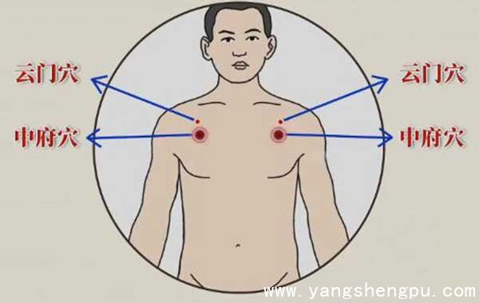
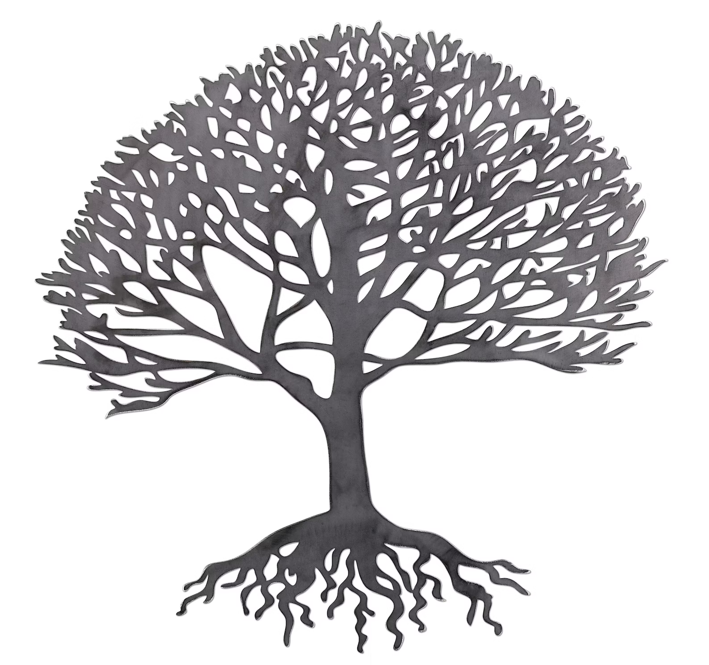
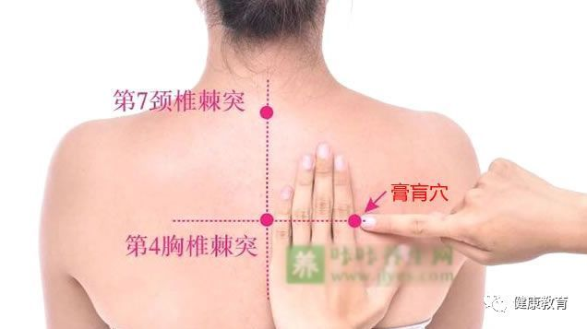
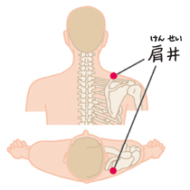
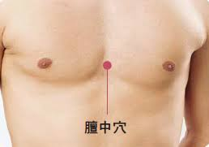
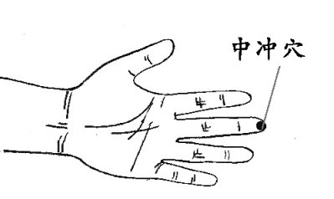
Movement 2：肩肘式 Elbows & Shoulders Stretch
Relevant acupoints:
中冲穴: Zhongchong: on pericardium meridian
肩井穴: Shoulder Well, on gallbladder meridian
云门穴: Cloud gate, on lung meridian
膻中穴: Sternum, on triple burners
膏肓穴: Gaohuang: rotating the elbow is self massaging these points with opening and closing
the shoulder blades.

Slide 6
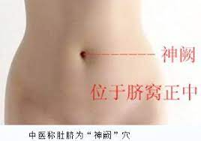
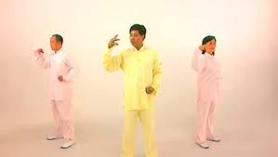
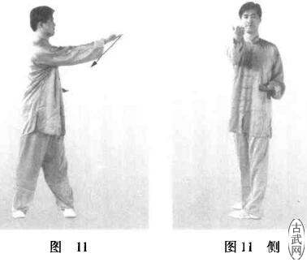
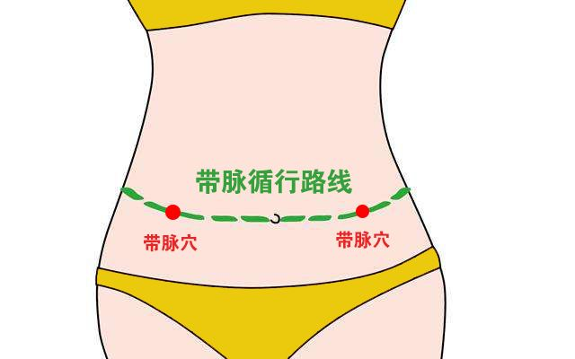
Relevant acupoints in Horizontal Waist Rotation
Movement 5：旋腰式 Horizontal Waist Rotation
Strengthening the Belt Meridian
Step-by-step movements
水平左转
水平右转
Mainly working on the Belt Meridian, increasing its control for the vertically flowing meridians

Slide 7
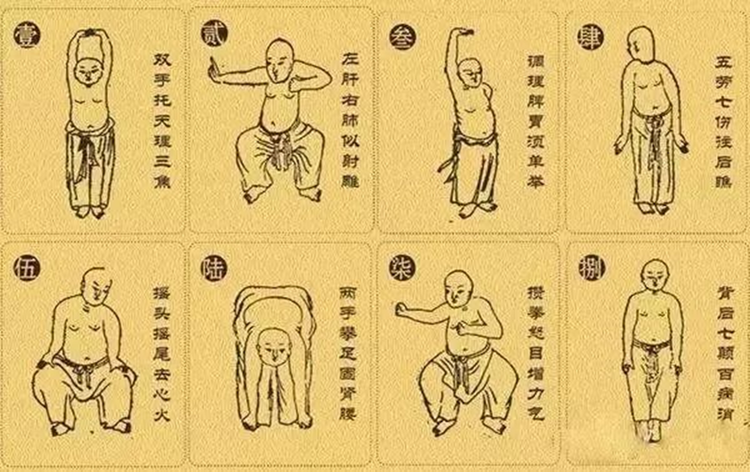
Origin & Development of – Baduanjin
Baduanjin: also called Eight Pieces of Brocade
Existed before Song Dynasty (960AD)
Southern style on soft knees, more gentle, while Northern style on low sitting stand, more strenuous
Went through major development in the past 400 years
The Health Qigong version was standardized with large teams of experts & clinical trials at the turn of the last century
Heavily promoted by the State Sports Administration of China
Most widely practised, inside and outside of China
Accessible to all ages and levels of fitness, with gentle stretching, natural (then controlled) breathing,
Easy to learn and remember, eight simple movements of gentle to medium intensity
Each movement has a clear function as described in the name
Regular practice of this gentle flowing exercise brings you mental clarity, greater flexibility and physical strength.
There are numerous YouTube links of Baduanjin. The link below is by Prof YANG Bailong from Beijing Sport University. He is the lead expert in the revised and updated official version of Baduanjin:
https://www.youtube.com/watch?v=-XmD9K68Wwc&t=37s

Slide 8
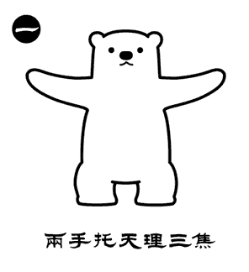
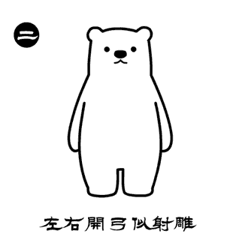
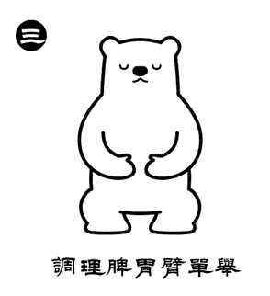
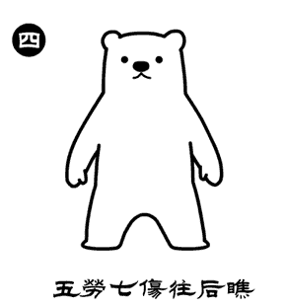
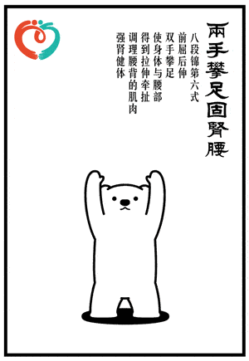
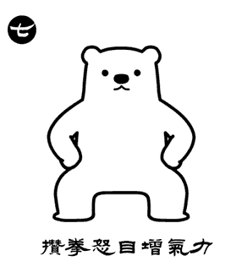
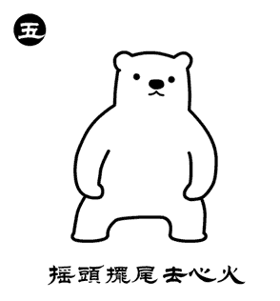
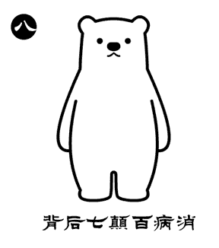

Slide 9
Any questions?
YuTaichi4You@gmail.com

